Slide 1
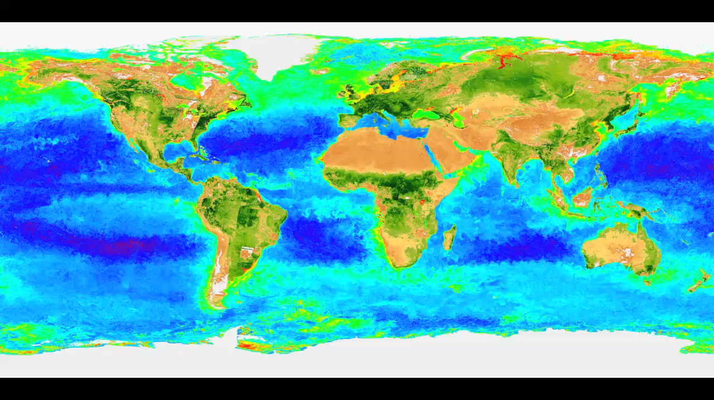
Notes:
Turbulent storms churn the ocean in winter, adding nutrients to sunlit waters near the surface. This sparks a feeding frenzy each spring that gives rise to massive blooms of phytoplankton. Tiny green molecules found inside these microscopic plants harvest vital energy from sunlight through photosynthesis. The natural pigments, called chlorophyll, allow phytoplankton to thrive in Earth’s oceans and enable scientists to monitor blooms from space. Satellites reveal the location and abundance of phytoplankton by detecting the amount of chlorophyll present in coastal and open waters. This visualization shows the first six years of biosphere data taken by the SeaWiFS instrument. On land, areas of high plant life are shown in dark green, while areas of low plant life are shown in tan. In the ocean, areas of high phytoplankton are shown in red, and areas of lowest phytoplankton are shown in blue and purple.
Satellite: SeaWIFS

