Slide 1
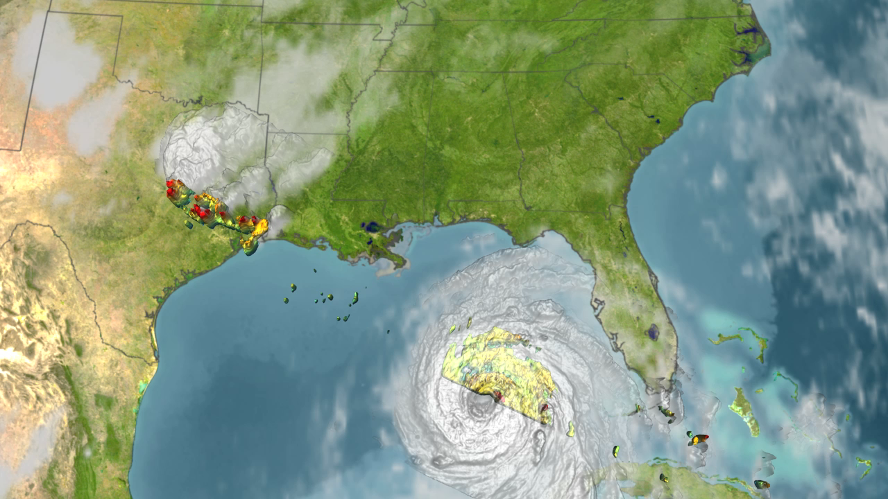
Notes:
HURRICANE KATRINA HOT TOWERS SVS CATALOG 3253
Tropical Rainfall Measuring Mission
NASA's TRMM spacecraft allows us to look under Hurricane Katrina's clouds to see the rain structure on August 28, 2005 at 0324Z. Spikes in the rain structure known as 'hot towers' indicate storm intensity. 'Hot Towers' refers to tall cumulonimbus clouds and has been seen as one of the mechanisms by which the intensity of a tropical cyclone is maintained. Because of the size (1-20 km) and short duration (30 minute to 2 hours) of these hot towers, studies of these events have been limited to descriptive studies from aircraft observations, although a few have attempted to use the presence of hot towers in a predictive capacity. Before TRMM, no data set existed that could show globally and definitively the presence of these hot towers in cyclone systems. Aircraft radar studies of individual storms lack global coverage. Global microwave or Infrared sensor observations do not provide the needed spatial resolution. With a ground resolution of 5 km, the TRMM Precipitation Radar provided the needed data set for examining the predictive value of hot towers in cyclone intensification.

