Slide 1
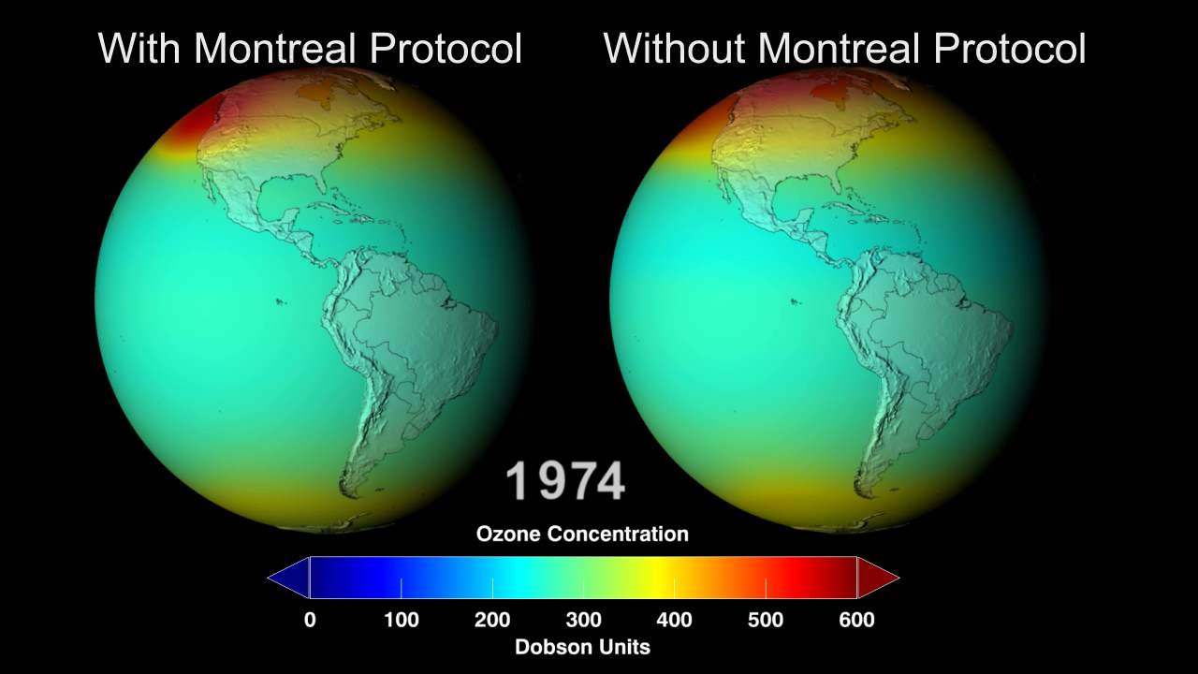
Notes:
Led by NASA scientist Paul Newman, a team of atmospheric chemists, simulated “what might have been” if chlorofluorocarbons (CFCs) and similar ozone-depleting chemicals were not banned through the Montreal Protocol in the 1980s. The comprehensive model—including atmospheric chemical effects, wind changes, and solar radiation changes—simulated what would happen to global concentrations of stratospheric ozone if CFCs were continually added to the atmosphere.
This visualizations presents two cases: the world “With the Montreal Protocol,” which assumes the current rate of emission, post-regulation, and the world “Without the Montreal Protocol,” (the world avoided) where the rate of CFC emission into the atmosphere is assumed to be that of the period before regulation. Both cases were extrapolated to the year 2065.

