Slide 1
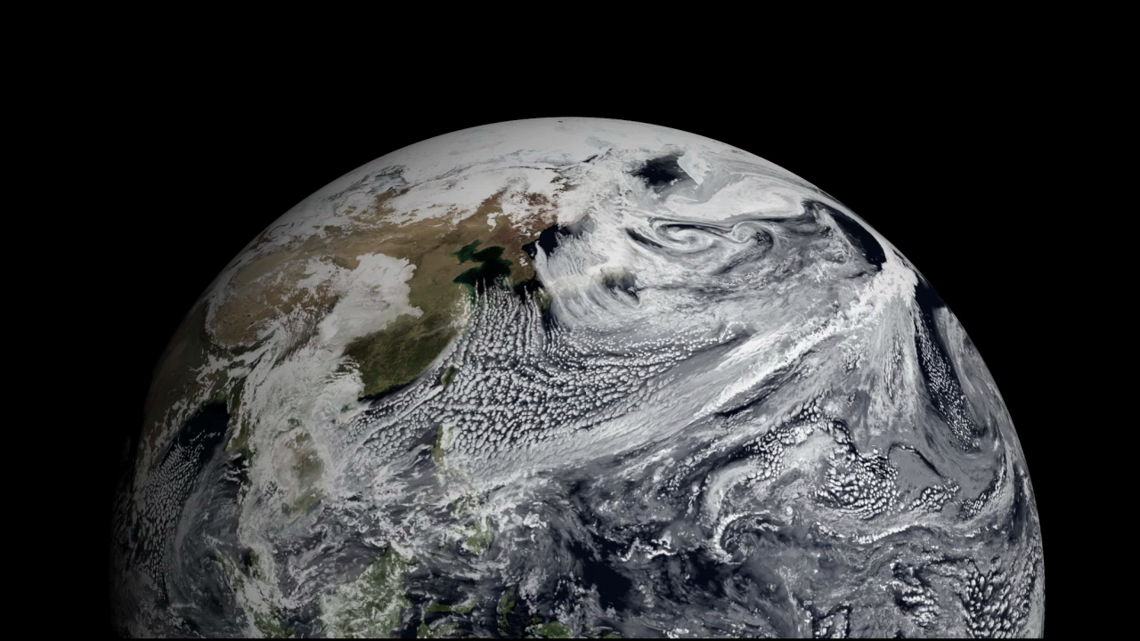
Notes:
A Sea of Clouds
Earth’s atmosphere is a fluid system not unlike our oceans, and both continuously work together to transport water around our planet. This visualization shows clouds from a simulation using the GEOS-5 model for January 2, 2009. The sea of white appears to flow effortlessly above Earth’s surface. Atmospheric winds steer the clouds in our atmosphere just as they steer the surface currents in our oceans, all the while exchanging water. Since there is only one day of simulation data, the sequence of clouds repeats several times. The white flash indicates the sequence is about to repeat.
SVS Animation 3722 - NCCS Hyperwall Show: Push in with GEOS-5 Modeled Clouds at 3.5-km Global Resolution and 10 Minute Interval

