Slide 1
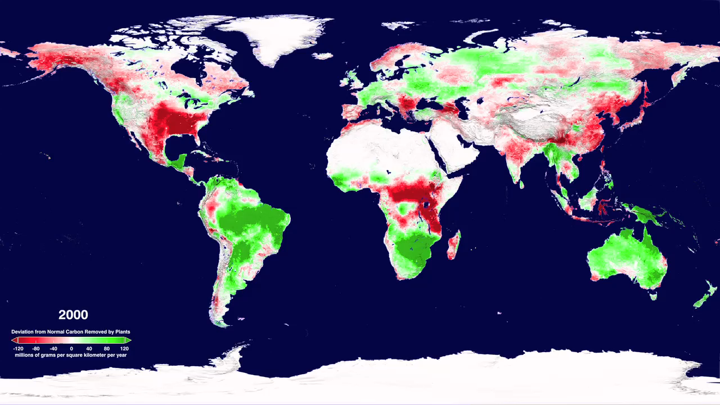
Notes:
HOW HAS THE ATMOSPHERIC CARBON UPTAKE FROM PLANTS CHANGED IN THE LAST DECADE?
SVS CATALOG 3765
Terra - MODIS
Plant life converts atmospheric carbon dioxide into biomass through photosynthesis. This process, called fixing, is one of the main ways in which carbon dioxide is removed from the atmosphere and is a major part of the carbon cycle. Plants release a fraction of this fixed carbon by respiration in order to get energy to live and to move carbon to other organs. The amount of carbon removed minus the amount of carbon respired is called the net primary productivity (NPP) and is the amount of carbon turned into biomass.
The change in NPP due to rising global temperatures is a very important factor in the response of the Earth to climate change. Measurements of radiation and leaf area from the MODIS instrument on NASA's Terra satellite have recently been used to calculate the change in NPP for the whole world for the last 10 years. This animation shows a time sequence of annual NPP anomalies on land as measured by MODIS during the years 2000 through 2009. Annual NPP, especially its departures from a long-term mean condition, will demonstrate the effects of environmental drivers such as ENSO (El Niño) events, climate change, droughts, pollution episodes, land degradation, and agricultural expansion.
Earlier studies of productivity between 1982 and 1999 showed that productivity went up as global temperatures rose, because longer, warmer growing seasons were better for plant growth. This new study indicates that this is still true in the northern hemisphere, but that increased temperatures have meant increased drought and dryness in the tropics and the southern hemisphere. As a result, the global net productivity has actually decreased in the period from 2000 through 2009.
Regionally, negative annual NPP anomalies were mainly caused by large-scale droughts. In 2000, droughts reduced NPP in North America and China; in 2002, droughts reduced NPP in North America and Australia; in 2003, drought caused by a major heat wave reduced NPP in Europe; in 2005, severe droughts in the Amazon, Africa, and Australia greatly reduced both regional and global NPP; from 2007 through 2009 over large parts

