Slide 1
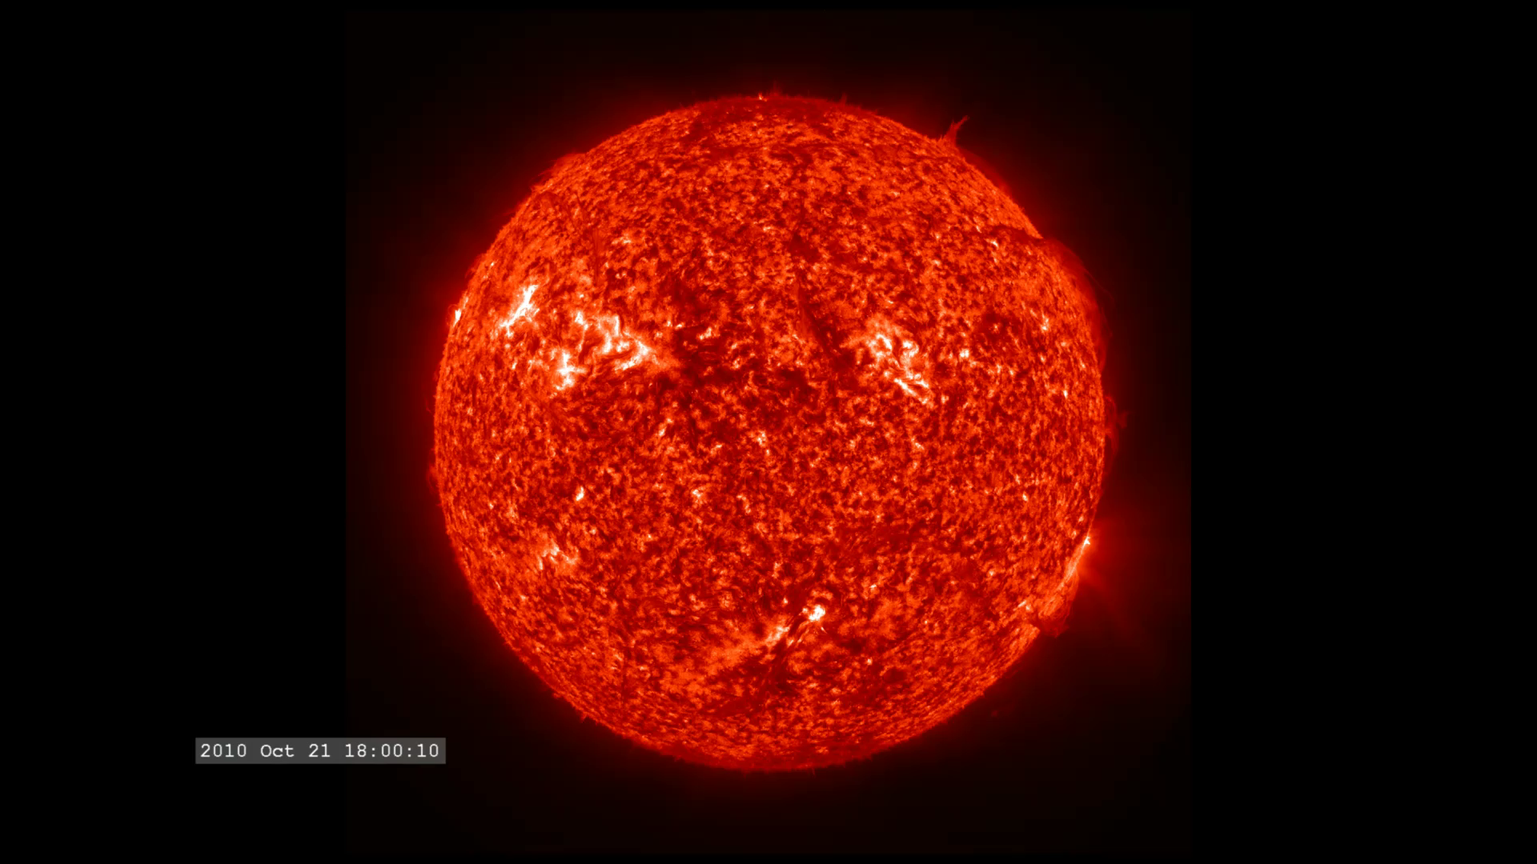
Notes:
The sun's activity increases as we enter solar cycle 24. But even several years away from the peak, the Sun in ultraviolet light shows a variety of activity.
This visualization consists of eight hours of SDO AIA imagery from the 30.4 nanometer filter (304 Ångstroms), October 21-22, 2012. This sequence plays at the full time cadence of the AIA instrument - one image every twelve seconds of real time—and showing thirty images per second on playback.
Satellite: SDO
Instrumewnt: AIA

