Slide 1
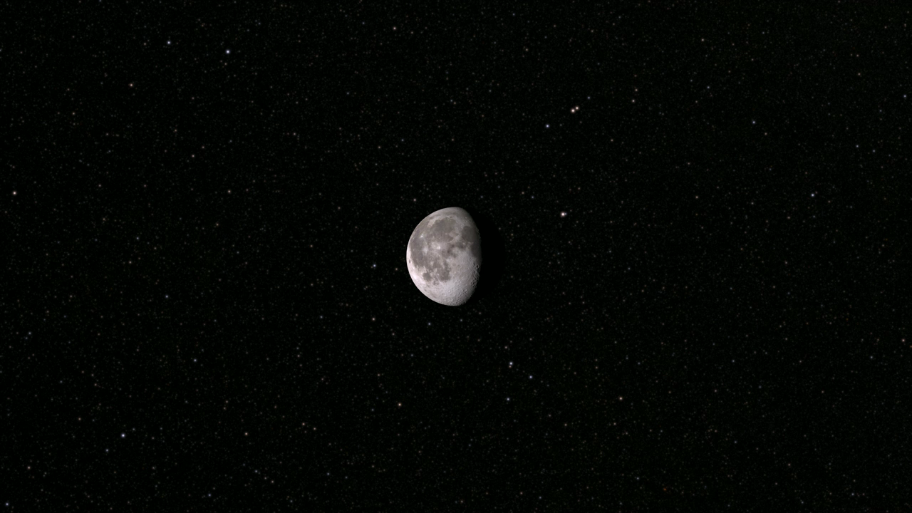

Notes:
Tour of the Moon
A condensed version of the tour. All of the featured sites are included.
Using elevation and image data returned by Lunar Reconnaissance Orbiter (LRO), aquired Aug 2009 to Sep 2011, this animation takes the viewer on a virtual tour of the Moon. The tour visits a number of interesting sites chosen to illustrate a wide variety of lunar terrain features. Some are on the near side and are familiar to both professional and amateur observers on Earth, while others can only be seen clearly from space. Some are large and old (Orientale, South Pole-Aitken), others are smaller and younger (Tycho, Aristarchus, Shackleton). Constantly shadowed areas near the poles are hard to photograph but easier to measure with altimetry, while several of the Apollo landing sites, all relatively near the equator, have been imaged at resolutions as high as 25 centimeters (10 inches) per pixel.
The shape of the terrain in this animation is based primarily on data from LRO's laser altimeter (LOLA), supplemented by stereo image data from its wide angle camera (LROC WAC) and from Japan's Kaguya mission. The global surface color is from Clementine. Kaguya/LISM/DTM temporal scale is from 15 Dec 2007.
Credit: NASA/Goddard Space Flight Center Scientific Visualization Studio
Source: http://svs.gsfc.nasa.gov/vis/a000000/a003800/a003874/
Short description:
This animation takes the viewer on a virtual tour of the Moon. The tour visits a number of interesting sites chosen to illustrate a wide variety of lunar terrain features.

