Slide 1
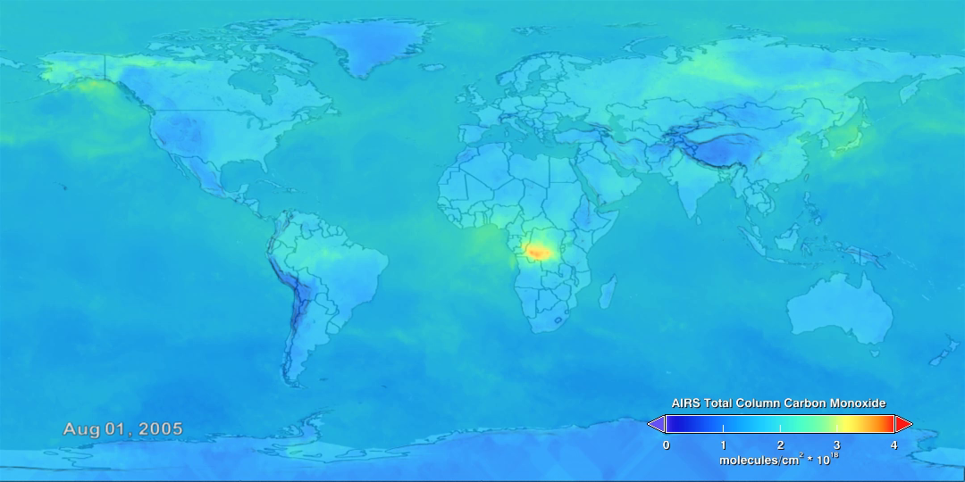
Notes:
Beyond the Flames of Fire
Forest fires produce carbon monoxide (CO) along with copious amounts of other gases and particulate matter that subsequently change Earth’s atmospheric composition. In the atmosphere, CO is short lived and therefore is detected close to its source. The CO seen here primarily comes from fires burning in the Amazon basin, with some additional contribution from fires in Southern Africa from AugustSeptember 2005. Instruments like the Atmospheric Infrared Sounder (AIRS)—aboard NASA’s Aqua satellite—measure global atmospheric CO on a daily basis and help scientist better understand the impacts of CO on the atmosphere.
SVS Animation 3882 - Carbon Monoxide

