Slide 1
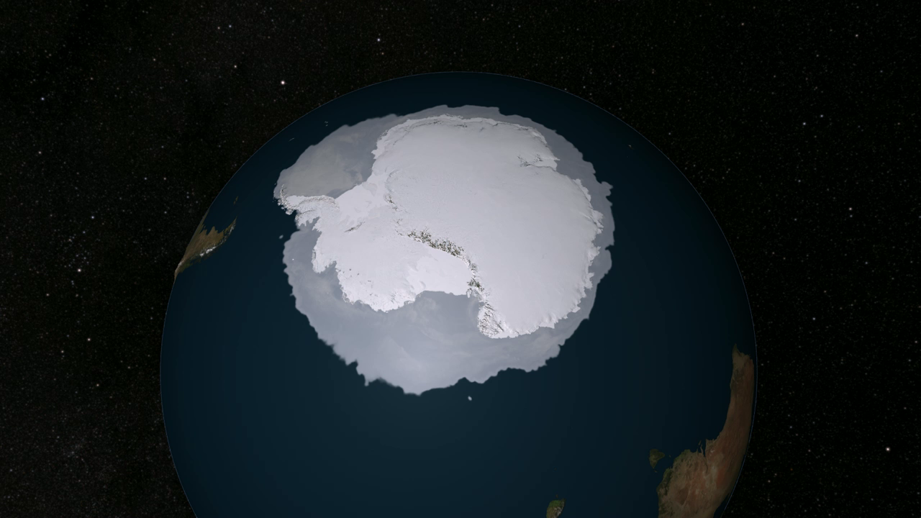
Notes:
The highly dynamic Pine Island Glacier is a large ice stream—a region of the ice sheet that moves significantly faster than the surrounding ice—located on the West Antarctic Ice Sheet. Scientists know that ice speeds in this area have increased dramatically from the late 1990s to the present as the ice shelves in this area have thinned and the bottom of the ice has lost contact with the bed beneath. As the ice accelerates, the ice upstream is stretched more vigorously, causing it to thin.
NASA-sponsored aircraft missions first measured the ice surface height in this region in 2002, followed by the Ice Clouds and Land Elevation Satellite (ICESat ) satellite between 2002 and 2009, and then the IceBridge aircraft mission from 2009 to present. Integrating these altimetry sources allow scientists to estimate surface-height changes across the most important drainage glacier in the region. They have found that large and accelerating elevation changes extend inland from the coast on Pine Island Glacier, shown in this animation.

