Slide 1
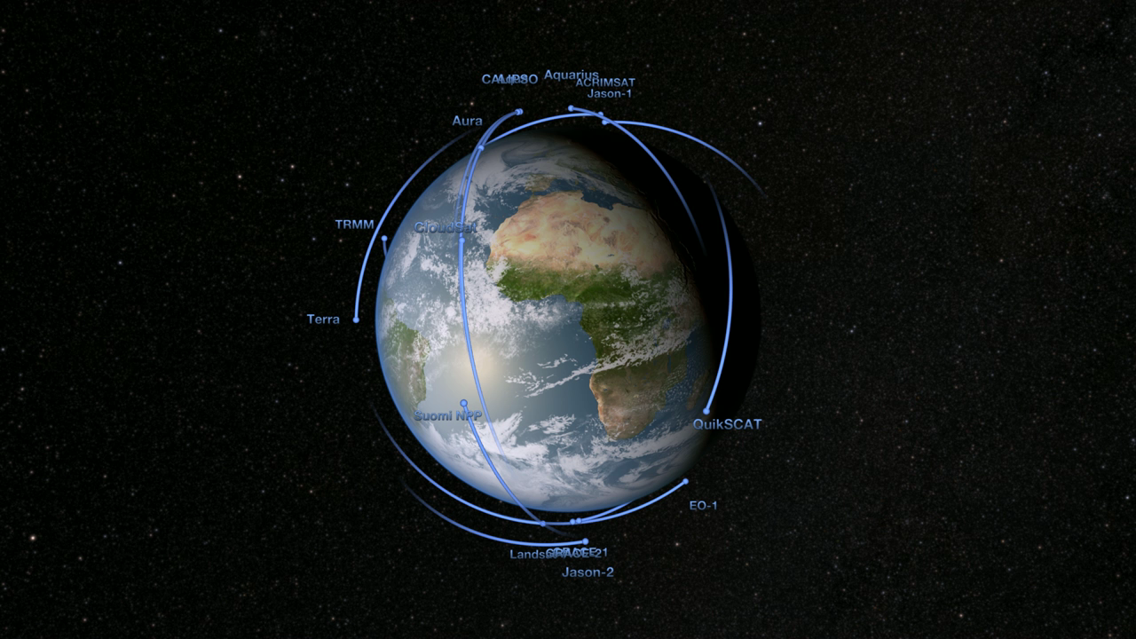
Notes:
International Satellites Under One Umbrella
As the old adage goes: “when it rains, it pours.” Unfortunately, scientists can’t rely on a single satellite to provide global precipitation data. That’s why NASA has teamed with the Japanese Space Exploration Agency and other international agencies to support the Global Precipitation Measurement (GPM) mission. GPM is an international satellite constellation with contributions from several international and domestic partners. Each satellite has its own purpose and mission, but the instruments aboard each satellite provide coverage of precipitation across the globe. The GPM Core Observatory satellite is equipped with two very important instruments that will provide three-dimensional images of rainfall and also extend our ability to measure light rain and snowfall. Ultimately, the GPM Core Observatory will unify measurements being taken by other instruments aboard other satellites and combine them into one global precipitation product.
SVS Animation 3891 - Global Precipitation Measurement (GPM) Orbital Fleet

