Slide 1
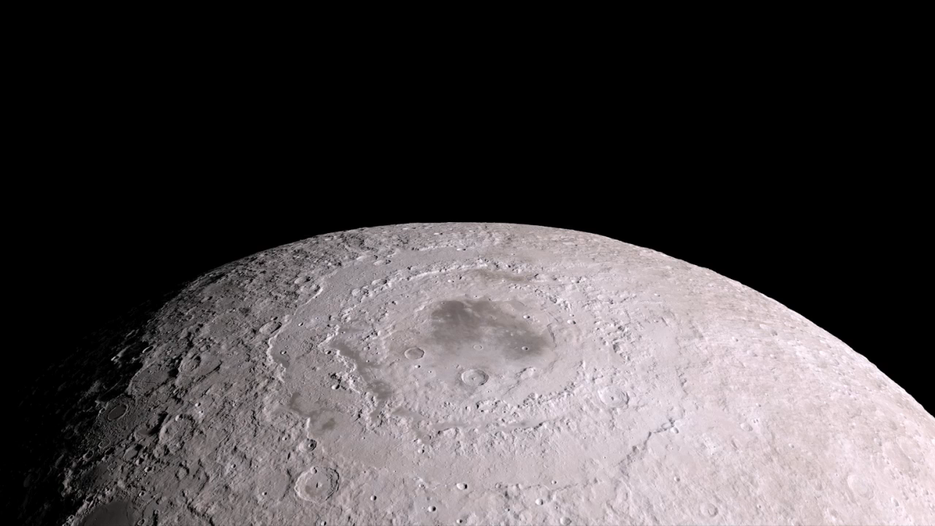
Notes:
Using elevation and image data returned by NASA’s Lunar Reconnaissance Orbiter (LRO), this visualization shows three distinct features on the moon. The first feature shown—Mare Oriental—is located on the western border between the moon’s nearside and farside. Formed by ancient volcanic eruptions, a lunar mare is a large, dark-colored basaltic plain. Next, the animation shows the Aristarchus crater located on the northwest section of the moon’s nearside. Aristarchus is considered the brightest of the large formations on the lunar surface. Last, the animation shows the well-lit Tycho crater located in the southern lunar highlands. LRO observations such as these have enabled numerous groundbreaking discoveries, creating a new picture of the moon as a dynamic and complex body.
Satellite: Lunar Reconnaissance Orbiter (LRO)

