Slide 1
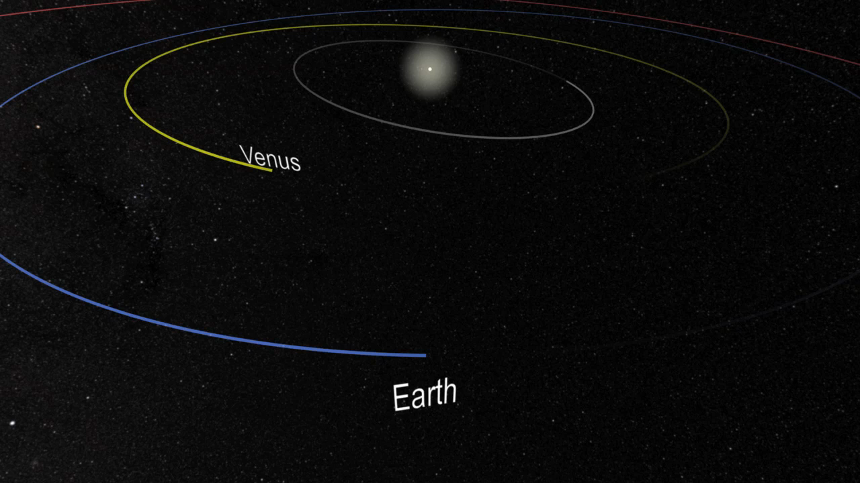
Notes:
Venus Transit – 2012
It was your last chance for the next 105 years.A transit is when a planet passes directly between the Sun and the Earth and we see the planet as a small dot moving slowly across the face of the Sun. A Venus transit occurred in 2004. Prior to that it was 1882. The last Venus transit occurred on June 5-6, 2012 and the next one won't occur until 2117.
To understand the significance of these events, it helps to know the history of how the Venus transits provided one of the first estimates of the size of the Solar System, and eventually the Universe. Conceptual development created via Standish Approximate Planetary Ephemerides.
Credit: NASA/Goddard Space Flight Center Scientific Visualization Studio
Source: http://svs.gsfc.nasa.gov/vis/a000000/a003900/a003943/
Short description:
This visualization shows a conceptual illustration of the last Venus transit which occurred on June 5-6, 2012. A transit is when a planet passes directly between the Sun and the Earth and we see the planet as a small dot moving slowly across the face of the Sun.

