Slide 1
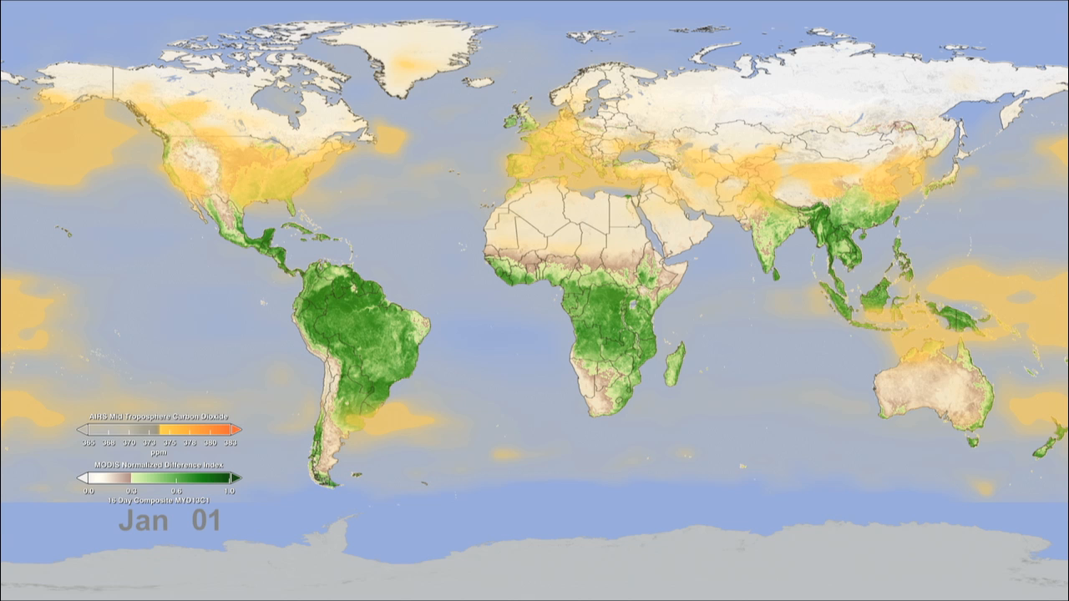
Notes:
Trees and plants participate in the carbon cycle by “inhaling” carbon dioxide and converting it into organic plant matter as part of the process of photosynthesis, thus removing carbon dioxide from the middle part of Earth’s lowest atmospheric layer—the troposphere. During Northern Hemisphere spring and summer for example, carbon dioxide in the troposphere decreases due to the large volume of new and growing vegetation, reaching a peak in late summer.
This animation shows daily average concentrations of mid-tropospheric carbon dioxide from January to December, shown in orange-yellow. The blooming effect of carbon dioxide follows a decrease in vegetation (green), as a result of seasonal changes (i.e., fall, winter). Data such as these give scientists an opportunity to better understand the relationship between carbon dioxide and the seasonal cycle of vegetation. The carbon dioxide values were made by averaging Atmospheric Infrared Sounder data from NASA’s Aqua satellite, collected between 2003 and 2010 (e.g., the data used for January 1 is actually an average of eight years of AIRS carbon dioxide data taken each year on January 1). The vegetation values were made using data from the Moderate Resolution Imaging Spectroradiometer (MODIS) averaged from 2003 to 2006.
Satellites: Aura, Aqua
Instruments: AIRS. MODIS

