Slide 1
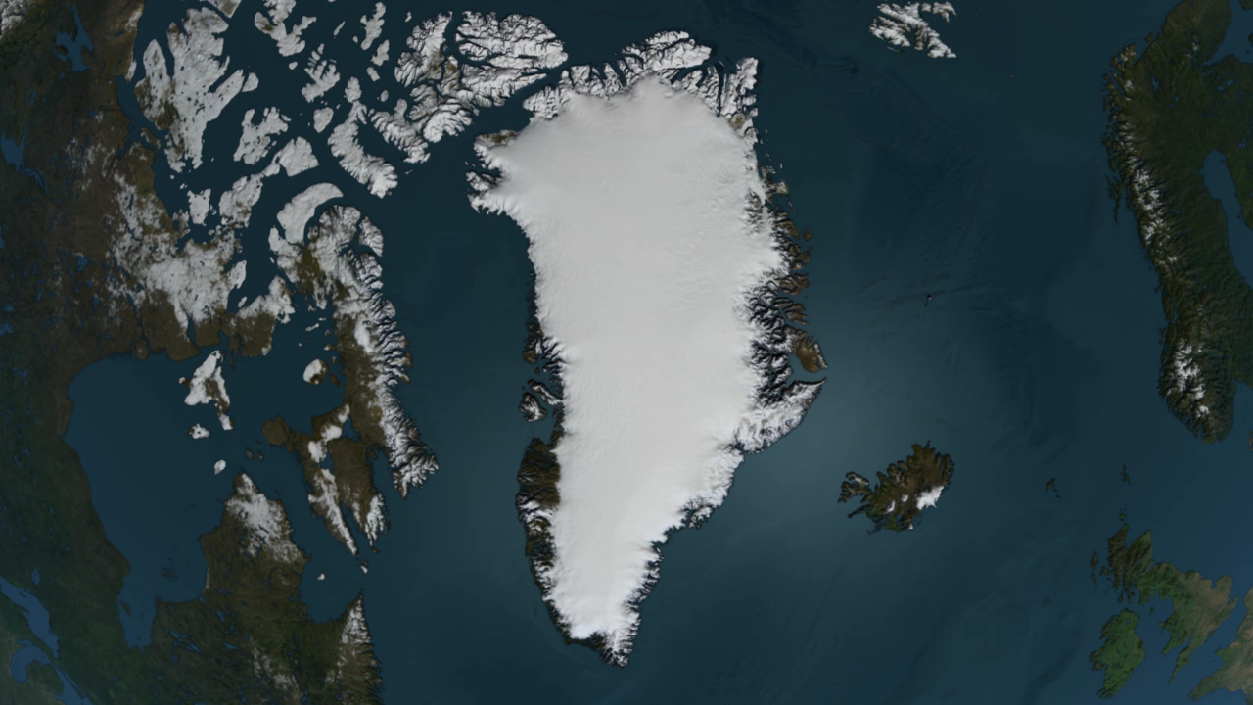
Notes:
Very little of Greenland is actually “green.” Instead, a vast ice sheet, and other relatively small isolated glaciers cover the majority of its surface. This animation shows how ice is naturally transported from interior topographic divides to the coast via outlet glaciers. The colors represent the speed of ice flow. Purple and fuchsia shades represent the fastest moving areas at rates of kilometers per year. The vectors indicate the direction of flow.
In the east, glaciers make their sinuous way through complex terrain, generally at low speeds. In the northwest and central west however, ice-flow speeds increase by nearly a factor of 10, with many smaller glaciers flowing straight down to the coastline. Scientists can detect the motion of ice using satellite radar interferometry. These data will help scientists improve their understanding of the dynamics of ice in Greenland and in projecting how the Greenland Ice Sheet will respond to climate change in the decades and centuries to come.

