Slide 1
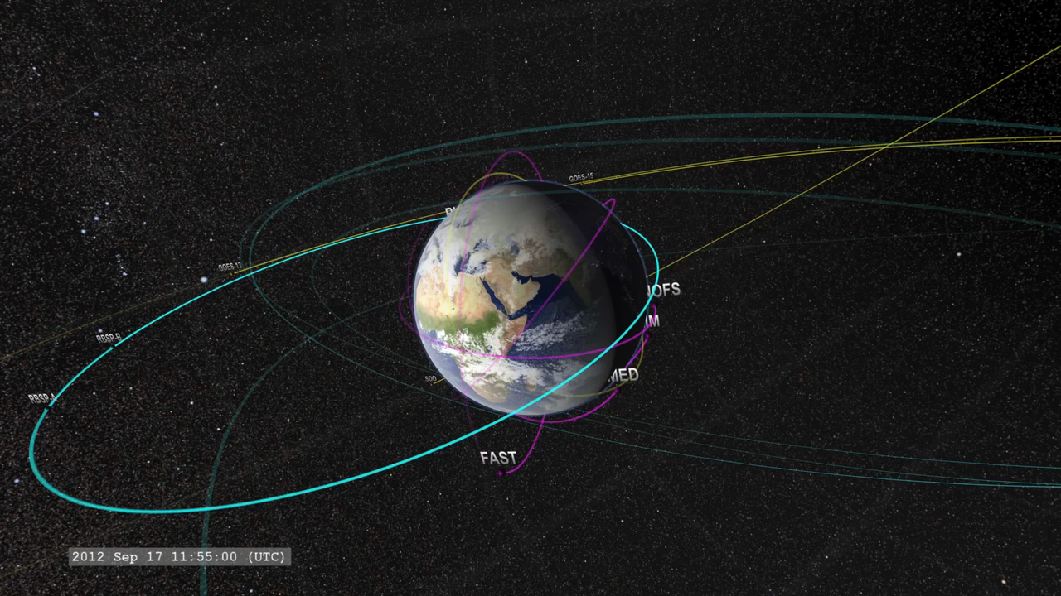
Notes:
The 2012 Earth-Orbiting Heliophysics Fleet
Since Sentinels of the Heliosphere in 2008, there have been a few new missions, and a few missions have been shut down. As of Fall of 2012, here's a tour of the NASA Near-Earth Heliophysics fleet, covering the space from near-Earth orbit out to the orbit of the Moon. The satellite orbits are color coded for their observing program: Magenta: TIM (Thermosphere, Ionosphere, Mesosphere) observations; Yellow: solar observations and imagery; Cyan: Geospace and magnetosphere and Violet: Heliospheric observations. Heliophysics Fleets consist of: Near-Earth Fleet, Geosynchronous Fleet, Geospace Fleet and Lunar Orbiting Fleet.
Credit: NASA/Goddard Space Flight Center Scientific Visualization Studio
Source: http://svs.gsfc.nasa.gov/vis/a000000/a003900/a003969/
Short description:
Here is a tour of the NASA Near-Earth Heliophysics fleet, covering the space from near-Earth orbit out to the orbit of the Moon. The satellite orbits are color coded for their observing program.

