Slide 1
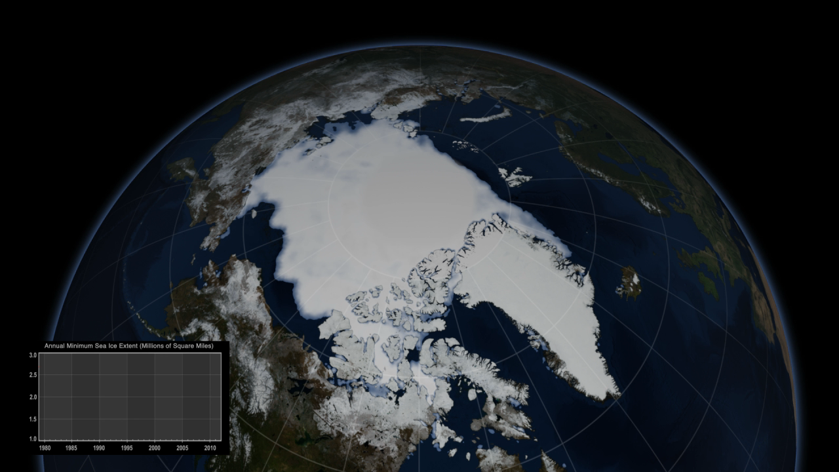
Notes:
Annual Arctic Sea Ice Minimum Extents (1979-2013)
The Arctic Ocean is capped by frozen seawater, called sea ice, that melts during Northern Hemisphere spring and summer months before generally reaching its minimum extent in September each year. Since 1978, satellites have monitored sea ice growth and retreat, and they have detected an overall decline in Arctic sea ice. This visualization shows annual minimum Arctic sea ice extents from 1979 to 2013. The graph shows a downward trend in the minimum extents over this time period.
The satellite observations, from passive microwave sensors, are processed using algorithms developed by scientists at NASA. The data from the different sensors are carefully assembled to assure consistency throughout the 35-year record.

