Slide 1
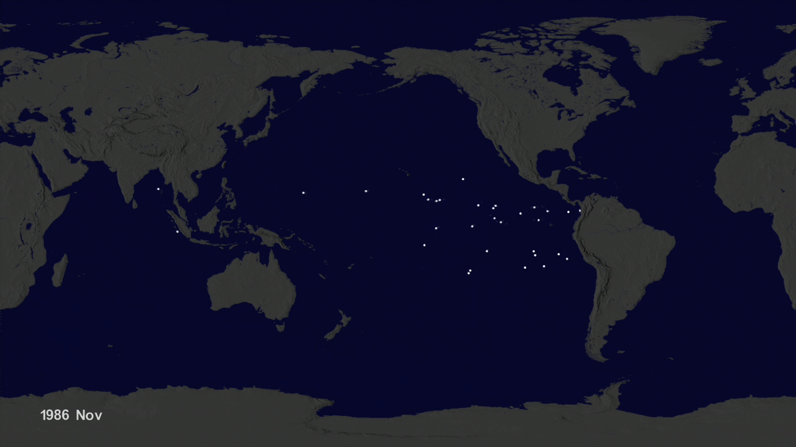
Notes:
Garbage Patch Experiment
An ocean gyre is a large system of circular ocean currents formed by global wind patterns and forces created by Earth’s rotation. Floating ocean debris tends to accumulate at the center of gyres where the water moves more slowly, similar to a whirlpool. The five main ocean gyres are located in the Indian Ocean, North Atlantic, North Pacific, South Atlantic, and South Pacific.
This visualization shows how modeled ocean currents carry modeled particles around the ocean. The modeled particles (dots) are released evenly around the world at the start of the visualization. The color of the dots denotes relative speed ranging from white (fastest moving particles) to dark blue (slowest moving particles). While there are likely seasonal variations in how the particles move, the general pattern shows that they migrate to the five known gyres also called ocean garbage patches. Scientists use ocean visualizations such as this one, created using data from the Estimating the Circulation and Climate of the Ocean (ECCO-2) model, to better understand ocean eddies and other narrow current systems, which transport heat, carbon, and other properties within the ocean.
For more information, visit:
svs.gsfc.nasa.gov/goto?4174

