Slide 1
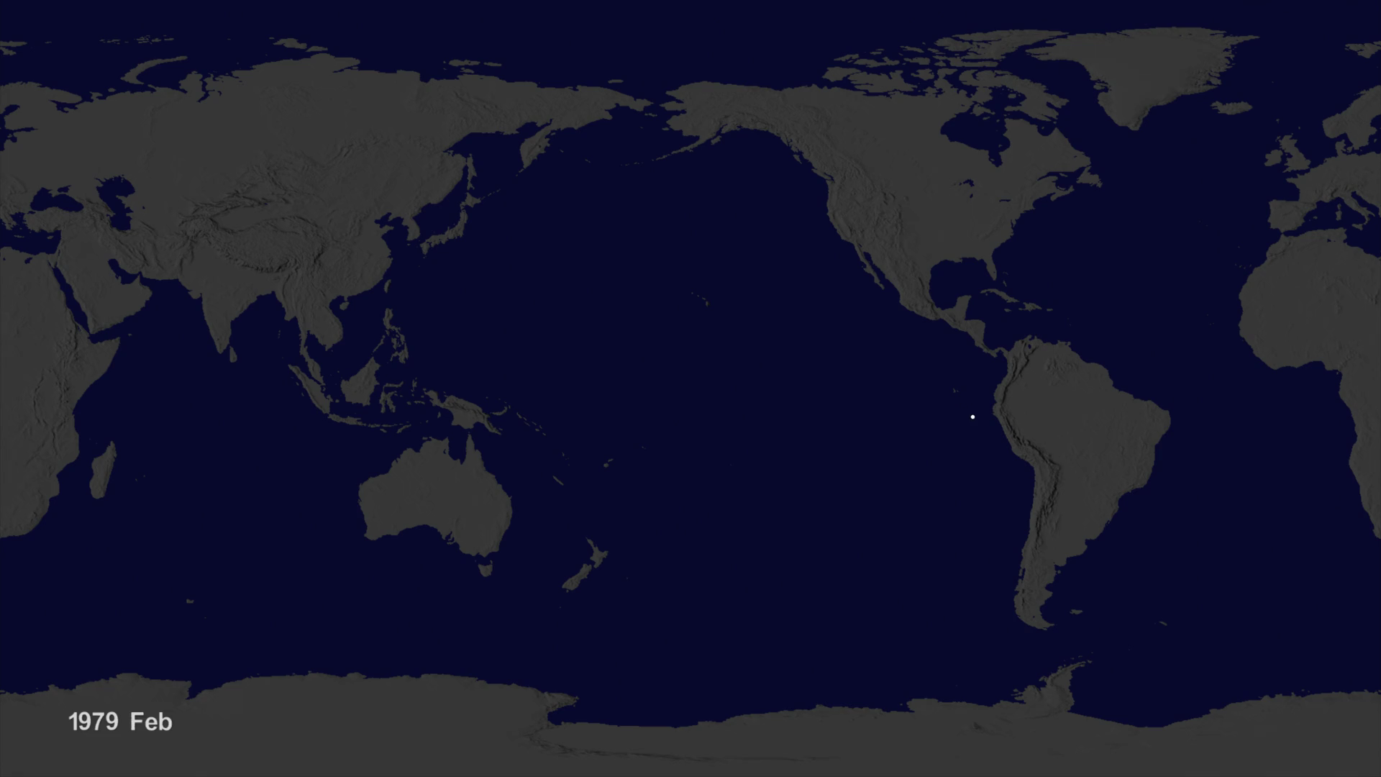
Notes:
The NOAA drifter buoys had been released at various times and locations around the world. As you watch new buoys get released, notice the patterns of the buoys. These are due to the way that they were release. For exmaple, a boat sailing in a roughly straight line might release a series of buoys every few hours causing a line of dots to appear; or, a bunch of buoys might be released near a research station making the buoys look like they all emerge from one location.

