Slide 1
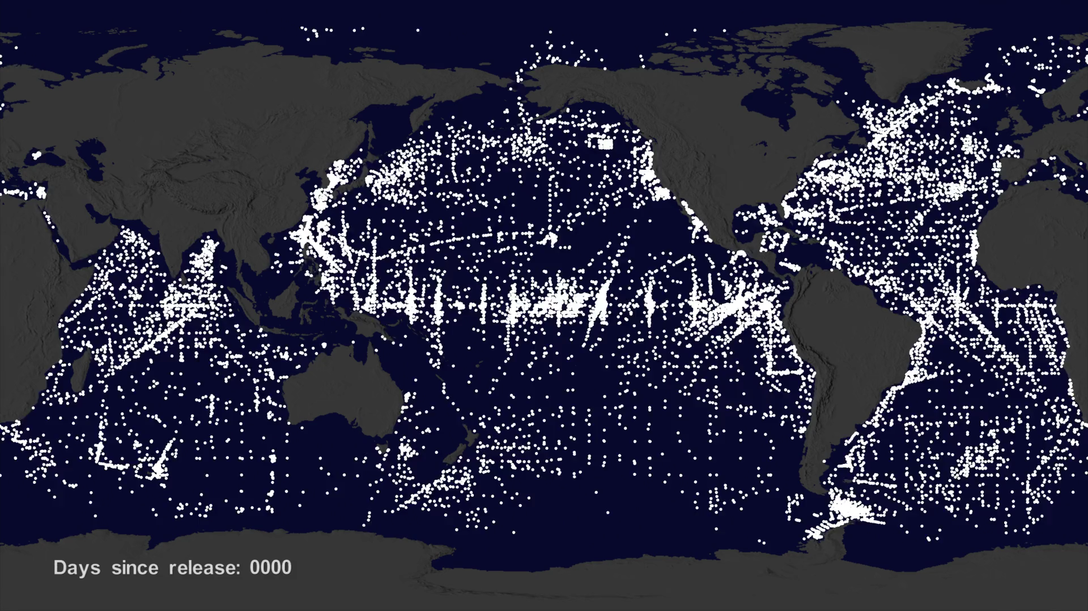
Notes:
In this visualization of the NOAA drifter buoys we shifted the timing of each buoy data set so that the start time of each buoy data set was the same. This means that the buoys you see at any particular time have been in the water the same amount of time. This also allows you to see the interesting patterns of buoy release. While there are likely seasonal variations in how buoys move, the general pattern shows that the buoys tend to move around until they move into slow moving larger circulation patterns which are the garbage patches.

