Slide 1
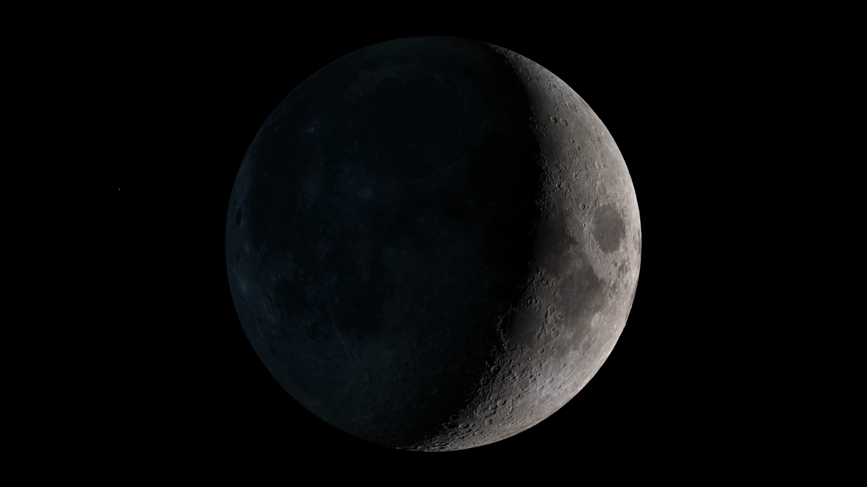
Notes:
Artist Concept as seen from Earth
On March 17, 2013, a NASA telescope that monitors the night side of the Moon recorded a bright flash in Mare Imbrium, at about 21°N, 24°W. The flash was one of the brightest ever recorded, and it was caused by the impact of a meteoroid estimated to be roughly a foot (30 to 40 cm) wide and just under a hundred pounds (40 kg), hitting the Moon at 60,000 miles per hour (25 km/sec).
A few months after the impact, the Lunar Reconnaissance Orbiter (LRO) camera team (LROC) found the crater formed by the impact. They compared LRO images taken before and after the impact and found a new crater 18 meters (60 feet) wide, with rays of ejecta that extend several kilometers.

