Slide 1
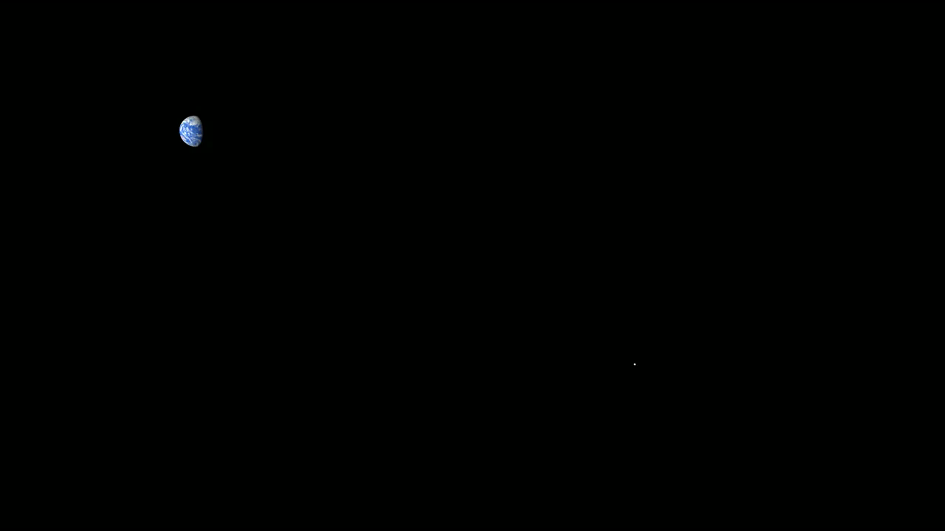
Notes:
On March 17, 2013, a NASA telescope that monitors the night side of the Moon recorded a bright flash in Mare Imbrium, at about 21&deg;N, 24&deg;W. The flash was one of the brightest ever recorded, and it was caused by the impact of a meteoroid estimated to be roughly a foot (30 to 40 cm) wide and just under a hundred pounds (40 kg), hitting the Moon at 60,000 miles per hour (25 km/sec).
A few months after the impact, the Lunar Reconnaissance Orbiter http://www.nasa.gov/mission_pages/LRO/main/ camera team http://lroc.sese.asu.edu/ found the crater formed by the impact. They compared LRO images taken before and after the impact and found a new crater 18 meters (60 feet) wide, with rays of ejecta that extend several kilometers.

