Slide 1
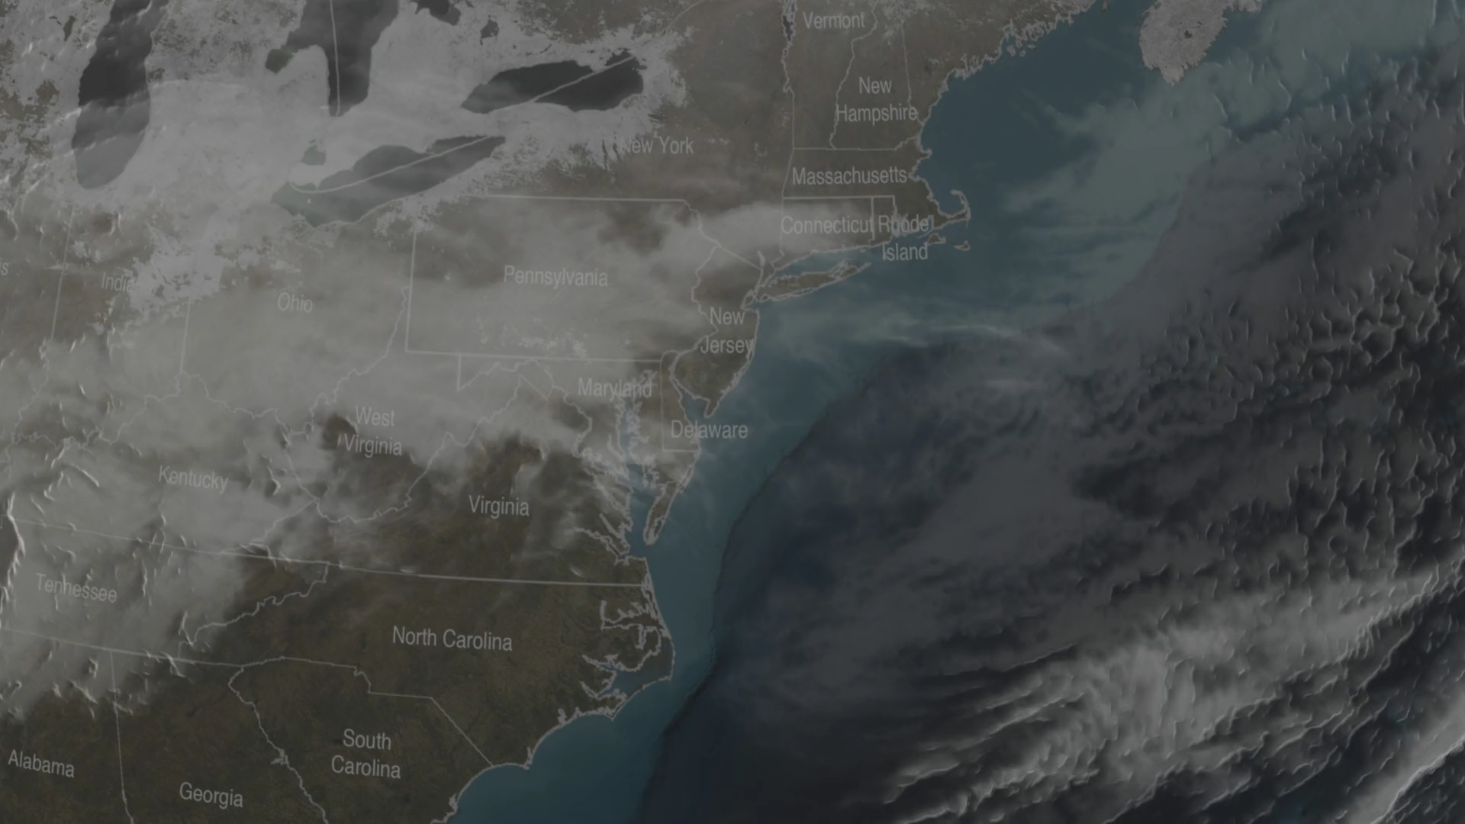
Notes:
New England Nor'easter, January 2015
The January 2015 North American blizzard, also unofficially named Winter Storm Juno was a powerful nor'easter that affected Canada and the Central and Eastern United States, and eventually, parts of Southern Greenland and Western Europe.
At 5:06 PM EST Monday, January 26, 2015, the Global Precipitation Measurement (GPM) Core Observatory flew over the nor'easter as it began dumping snow on New England. This visualization shows liquid precipitation rainfall rates (green to red) as well as frozen precipitation, or snowfall rates (purple to blue). The center of the storm, shown in 3-D, was offshore with far-reaching bands of snowfall. More intense snowfall rates (blue), can be seen on the northern edge of the storm and also over land up the coast from New York to Maine and into Canada, as well in the upper atmosphere before turning to heavy rainfall over the ocean.
For more information, visit:
svs.gsfc.nasa.gov/goto?4266

