Slide 1
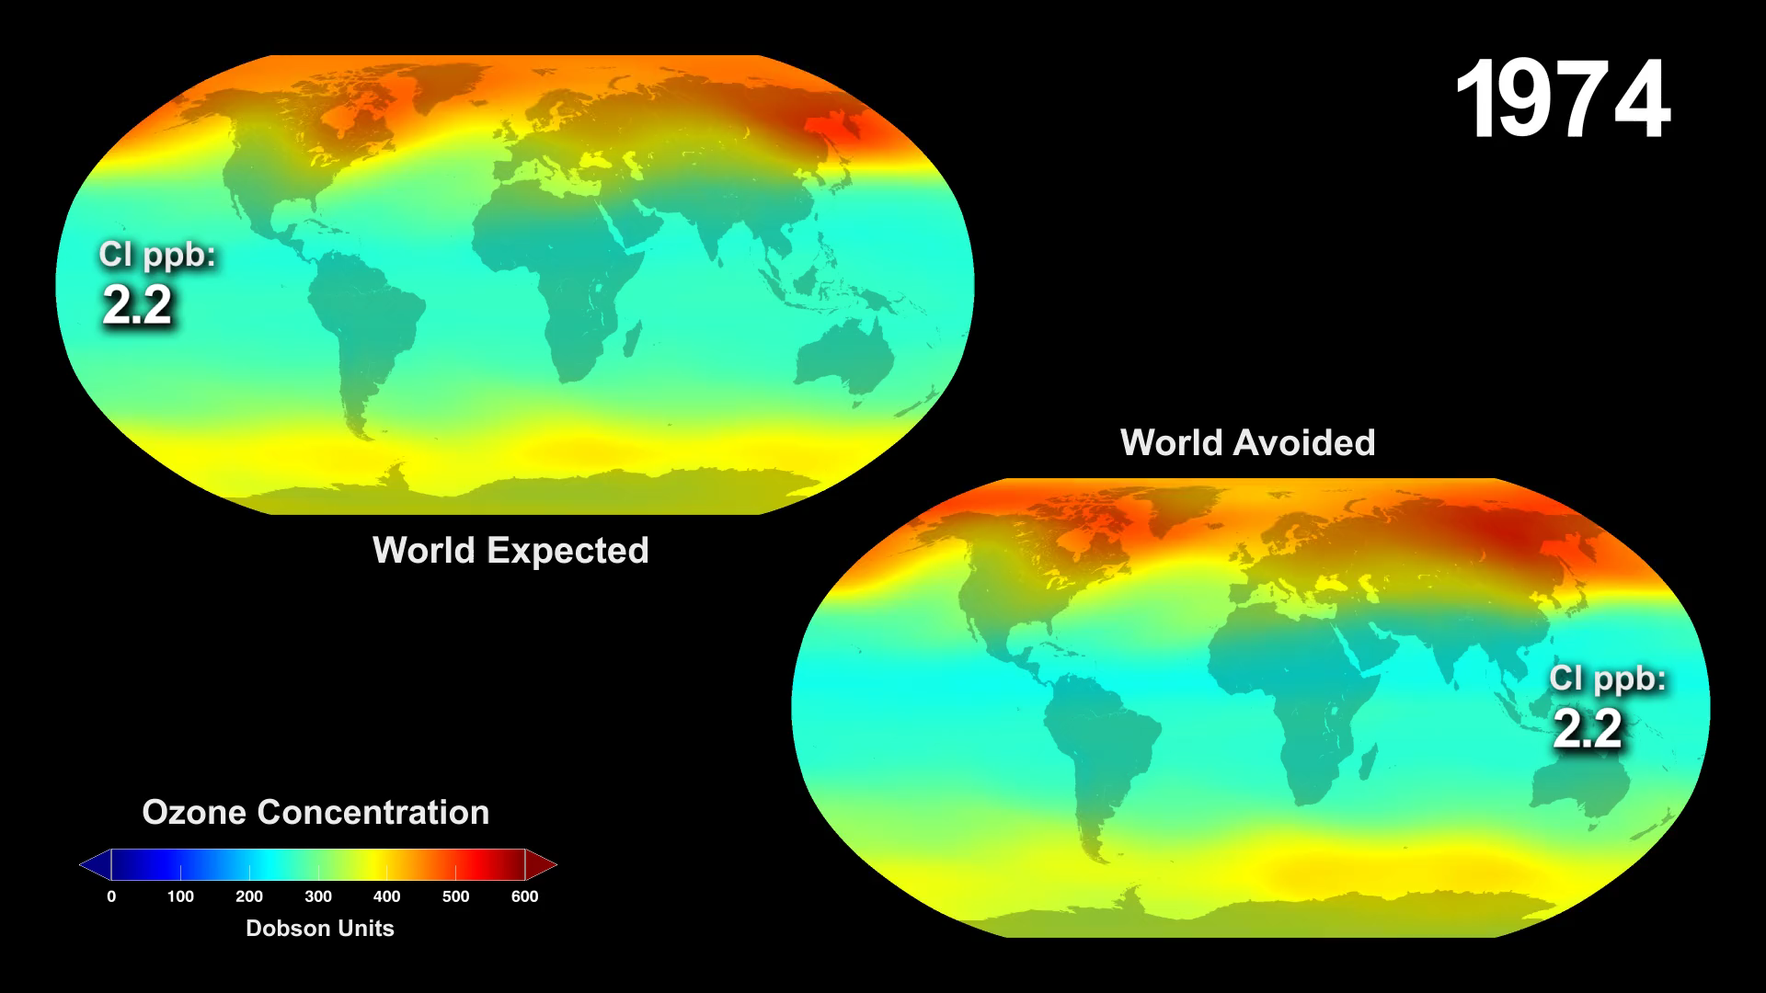
Notes:
World Avoided
Led by NASA Goddard scientist Paul Newman, a team of atmospheric chemists simulated 'what might have been' if chlorofluorocarbons (CFCs) and similar ozone-depleting chemicals were not banned through the Montreal Protocol. The comprehensive model — including atmospheric chemical effects, wind changes, and solar radiation changes — simulated what would happen to global concentrations of stratospheric ozone if CFCs were continually added to the atmosphere.
The visualizations below present two cases: the 'world avoided' case, where the rate of CFC emission into the atmosphere is assumed to be that of the period before regulation, and the 'projected' case, which assumes the current rate of emission, post-regulation. Both cases extrapolate to the year 2065.
For more information: svs.gsfc.nasa.gov/goto?4272

