Slide 1
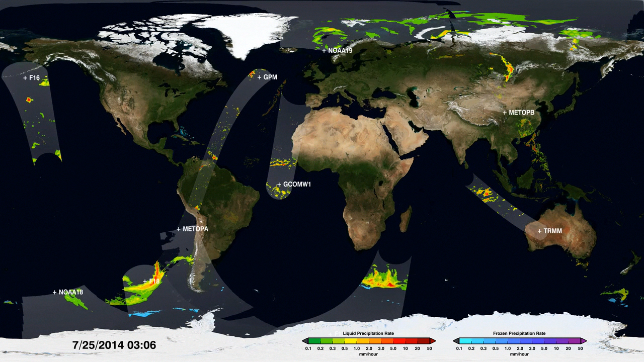
Notes:
Painting the World with Water
The Global Precipitation Measurement (GPM) mission—a network of international satellites including the GPM Core Observatory—provides unprecedented observations of Earth’s precipitation. This visualization shows the GPM constellation in action, revealing precipitation measurements underneath each satellite orbit. As time progresses and the precipitation measurements begin to cover the Earth's surface, global precipitation patterns become clear. For example, constant rainfall is visible along the Equator and scattered storms continuously pop up across the mid-latitudes. The dynamic nature of precipitation is revealed as time speeds up and the satellite data swaths merge into a continuous animation of changing rain and snowfall. Finally, the video fades into an animation created using the Integrated Multi-satellite Retrievals for GPM (IMERG) product, the newly available dataset of global precipitation every 30 minutes that is derived from GPM constellation data.
For more information, visit:
svs.gsfc.nasa.gov/goto?4283

