Slide 1
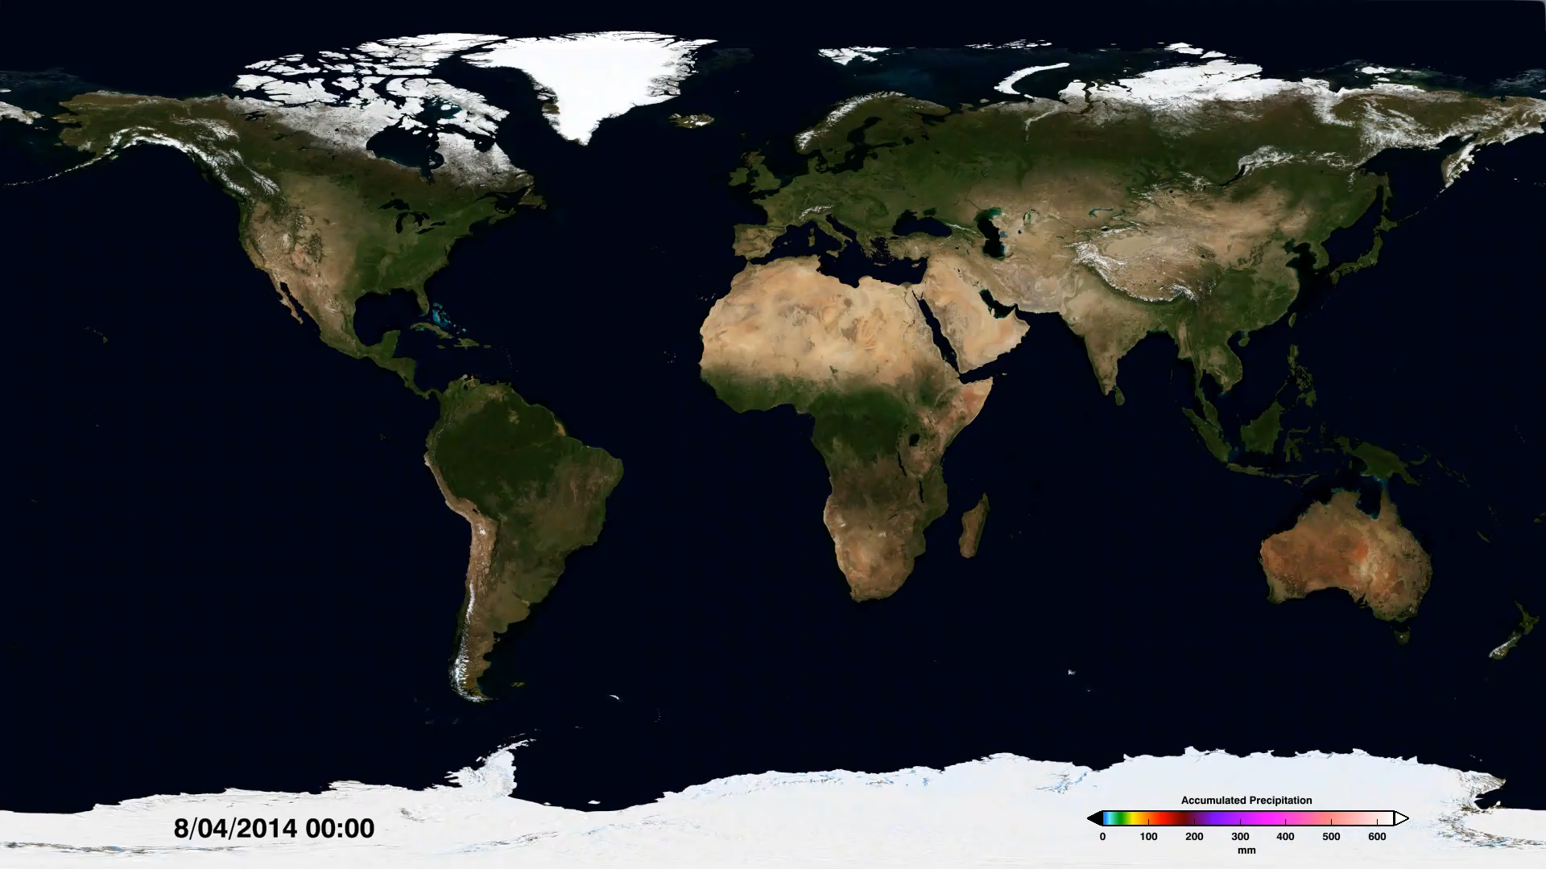
Notes:
Accumulated Precipitation from IMERG
The global Integrated Multi-satellite Retrievals for GPM (IMERG) precipitation dataset provides global rain and snowfall rates for the entire world every 30 minutes. IMERG is derived using data from the Global Precipitation Measurement (GPM) mission—a network of international satellites including the GPM Core Observatory. Using this dataset, it is possible to calculate the amount of accumulated rainfall for any region over a given period of time.
This animation shows the accumulation of rainfall across the globe for a week in August 2014. In addition to the dramatic accumulation near Japan due to Typhoon Halong and the track of Hurricane Bertha off the eastern coast of the United States, it is also possible to see a rare August storm over the North Sea near Europe, the origins of Hurricane Gonzalo on the western coast of Africa, and a deep tropical depression that produced floods across northern India. As scientists work to understand all the elements of Earth’s climate and weather systems, and how they could change in the future, GPM provides a major step forward in providing the scientific community comprehensive and consistent measurements of precipitation.
For more information, visit:
svs.gsfc.nasa.gov/goto?4284

