Slide 1
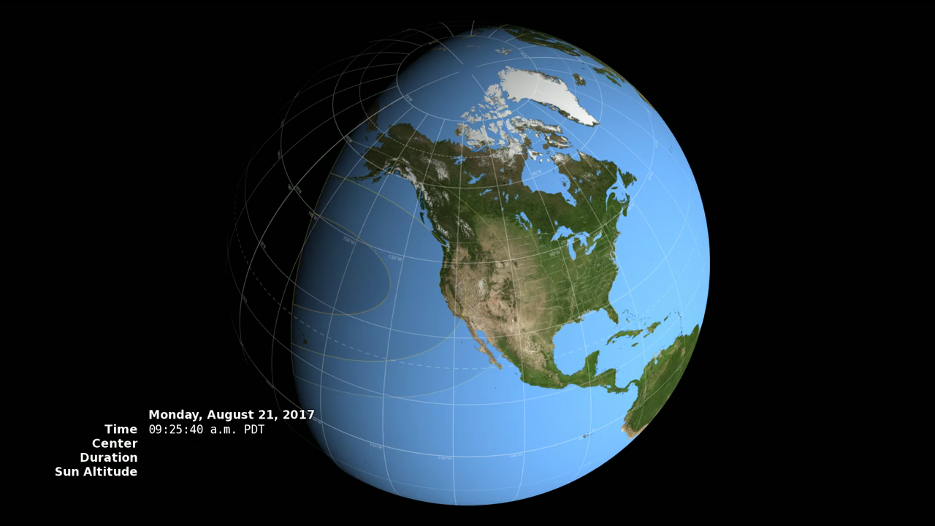
Notes:
On Monday, August 21, 2017, the Moon will pass in front of the Sun, casting its shadow across all of North America. This will be the first total solar eclipse visible in the contiguous United States in 38 years.
The Moon's shadow can be divided into areas called the umbra and the penumbra. Within the penumbra, the Sun is only partially blocked, and observers experience a partial eclipse. The much smaller umbra lies at the very center of the shadow cone, and anyone there sees the Moon entirely cover the Sun in a total solar eclipse.
In the animation, the umbra is the small black oval. The red streak behind this oval is the path of totality. Anyone within this path will see a total eclipse when the umbra passes over them. The much larger shaded bullseye pattern represents the penumbra. Steps in the shading denote different percentages of Sun coverage, at levels of 90%, 75%, 50% and 25%. The yellow and orange contours map the path of the penumbra. The outermost yellow contour is the edge of the penumbra path. Outside this limit, no part of the Sun is covered by the Moon.
The numbers in the lower left corner give the latitude and longitude of the center of the umbra as it moves eastward, along with the altitude of the Sun above the horizon at that point. Also shown is the duration of totality: for anyone standing at the center point, this is how long the total solar eclipse will last. Note that the duration varies from just 2 minutes on the West Coast to 2 minutes 40 seconds east of the Mississippi River.

