Slide 1
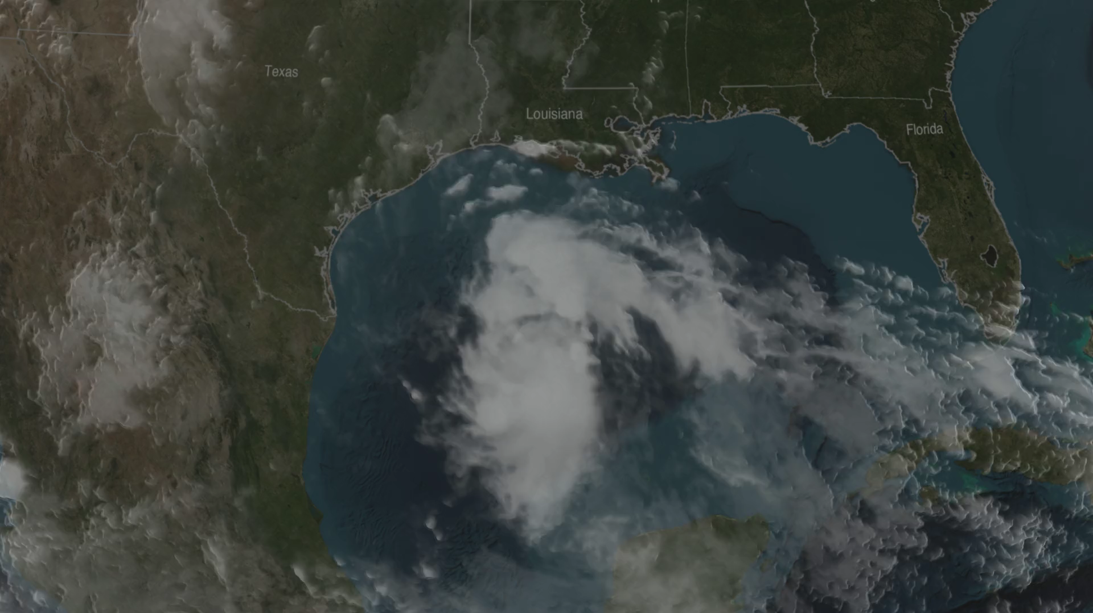
Notes:
Tropical Storm Bill
Tropical Storm Bill made landfall over Texas at approximately 11:45am CST on June 16, 2015. Shortly after midnight, GPM passed over the storm as it slowly worked its way northward across the already drenched state of Texas. This visualization shows Bill at precisely 12:11:27am CST (6:11:27 GMT) on June 17, 2015.
The GPM Core Observatory carries two instruments that show the location and intensity of rain and snow, which defines a crucial part of the storm structure – and how it will behave. The GPM Microwave Imager sees through the tops of clouds to observe how much and where precipitation occurs. The Dual-frequency Precipitation Radar provides the three-dimensional view, showing the structure of the storm spiraling inward toward the center, with heavier rain on the north side of the storm. Shades of blue represent ice in the upper part of clouds. Viewed from the side, the stark color change from blue to green marks the transition from ice to rain.
For more information: svs.gsfc.nasa.gov/goto?4316

