Slide 1
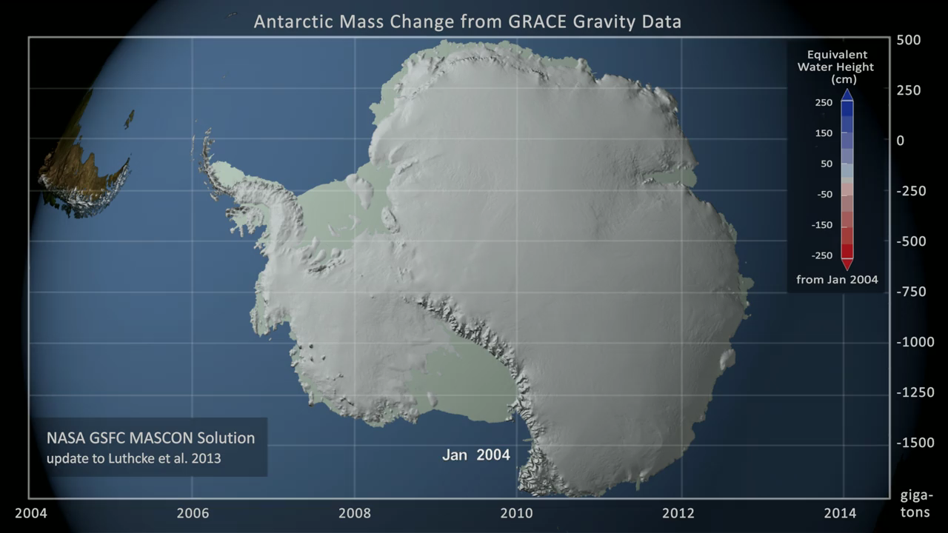
Notes:
GRACE, NASA's Gravity Recovery and Climate Experiment, consists of twin co-orbiting satellites that fly in a near polar orbit separated by a distance of 220 km. GRACE precisely measures the distance between the two spacecraft in order to make detailed measurements of the Earth's gravitational field. Since its launch in 2002, GRACE has provided a continuous record of changes in the mass of the Earth's ice sheets.
This animations shows the change in the mass of the Antarctic Ice Sheet between January 2004 and June 2014 as measured by the pair of GRACE satellites. The 1-arc-deg NASA GSFC mascon solution data was resampled to a 5130 x 5130 data array using Kriging interpolation. A color scale was applied in the range of +250 to -250 centimeters of equivalent water height, where blue values indicate an increase in the ice sheet mass while red shades indicate a decrease. In addition, a graph overlay shows the running total of the accumulated mass change in gigatons.
The data is first shown over the entire Antarctic Ice Sheet with the graph showing the total change in gigatons for the full ice sheet. The camera then zooms to focus on the West Antarctic Ice Sheet, the region to the West of the Trans-Antarctic mountains, where much of the loss has taken place. The animation is shown again over this region while the graph of ice loss presents the change over West Antarctica alone. Regions composed of the floating ice shelves, and thus not a part of the Antarctic Ice Sheet, are shown in a pale shade of green.
Technical Note: The glacial isostatic adjustment signal (Earth mass redistribution in response to historical ice loading) has been removed using the ICE-6G model (Peltier et al. 2015).

