Slide 1
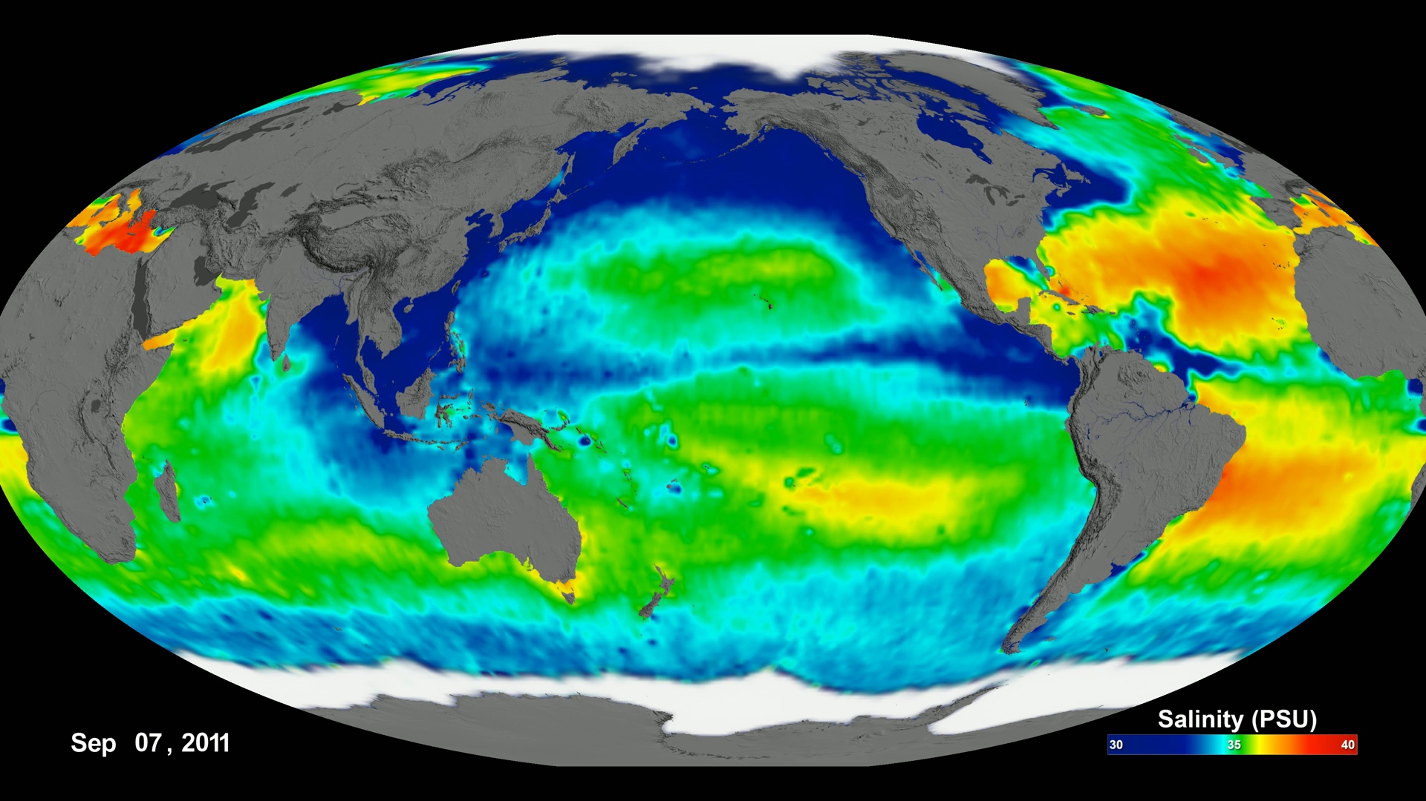
Notes:
Aquarius is a collaboration between NASA and the Space Agency of Argentina to measure global sea surface salinity (the amount of dissolved salts in water). Measuring salinity can help us better understand the water cycle and can also lead to improved climate models.
The visualizations show the complete observations of sea surface salinity taken during the life span (2011 through May 2015) of the Aquarius spacecraft. In these visualizations, sea surface salinity is shown ranging from 30 to 40 PSU (from blue to green to red) on a flat map using simple cartesian and extended Molleide projections. The visualizations were generated based on version 4.0 of the Aquarius data products.

