Slide 1
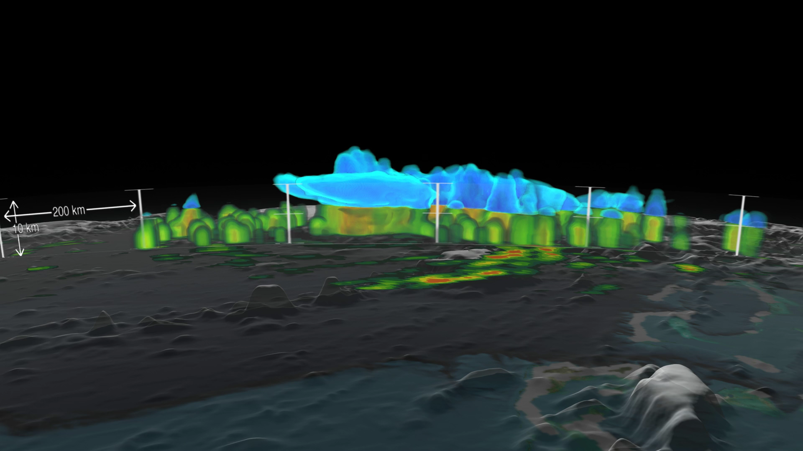
Notes:
Joaquin became a tropical storm Monday evening (EDT) midway between the Bahamas and Bermuda and has now formed into a hurricane. Joaquin is the 3rd hurricane of the 2015 season, though it could be the first to impact the US East Coast.
This visualization shows a 3D view of Joaquin via GPM's Dual-frequency Precipitation Radar on September 29th, 2015 21:39Z. The visualization shows a large area of very intense rain with rain rates ranging from around 50 to 132 mm/hr (~2 to 5 inches) just to the right of the center. This is a strong indication that large amounts of heat are being released into the storm's center, fueling its circulation and providing the means for its intensification. Associated with the area of intense rain is an area of tall convective towers with tops reaching above 16 km. Part of the snow aloft (in blue shades) extends as an anvil across the western part of the storm.This feature indicates that vertical wind shear (difference of winds with height) is strong, and can serve to rip a storm apart.
http://svs.gsfc.nasa.gov/cgi-bin/details.cgi?aid=4371

