Slide 1
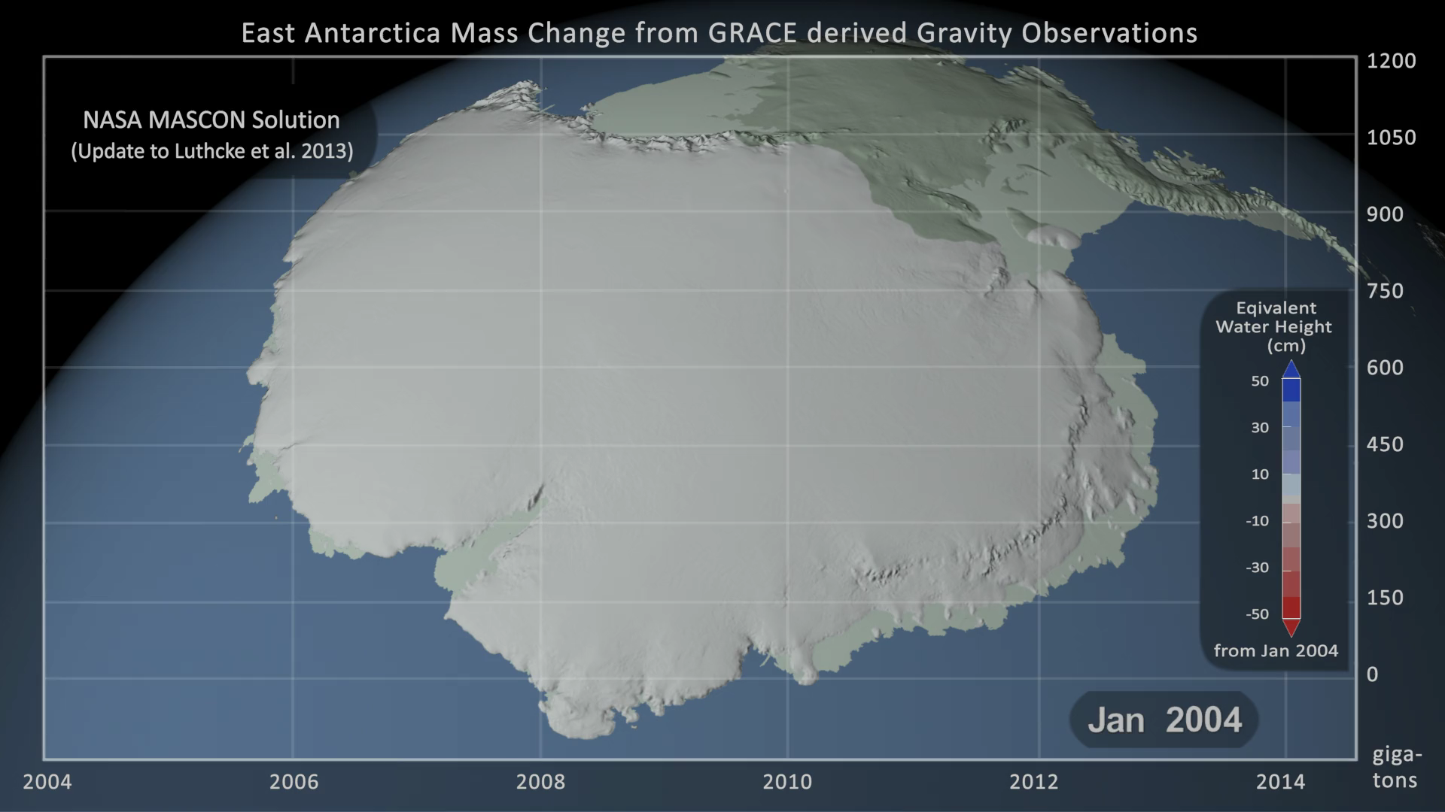
Notes:
Antarctic Mass Change from GRACE
GRACE, NASA's Gravity Recovery and Climate Experiment, consists of twin co-orbiting satellites that fly in a near polar orbit separated by a distance of 220 km. GRACE precisely measures the distance between the two spacecraft in order to make detailed measurements of the Earth's gravitational field. Since its launch in 2002, GRACE has provided a continuous record of changes in the mass of the Earth's ice sheets.
This animation shows the change in the mass of the Antarctic Ice Sheet between January 2004 and June 2014 as measured by the pair of GRACE satellites. Blue values indicate an increase in the ice sheet mass while red shades indicate a decrease. In addition, a graph overlay shows the running total of the accumulated mass change in gigatons.

