Slide 1
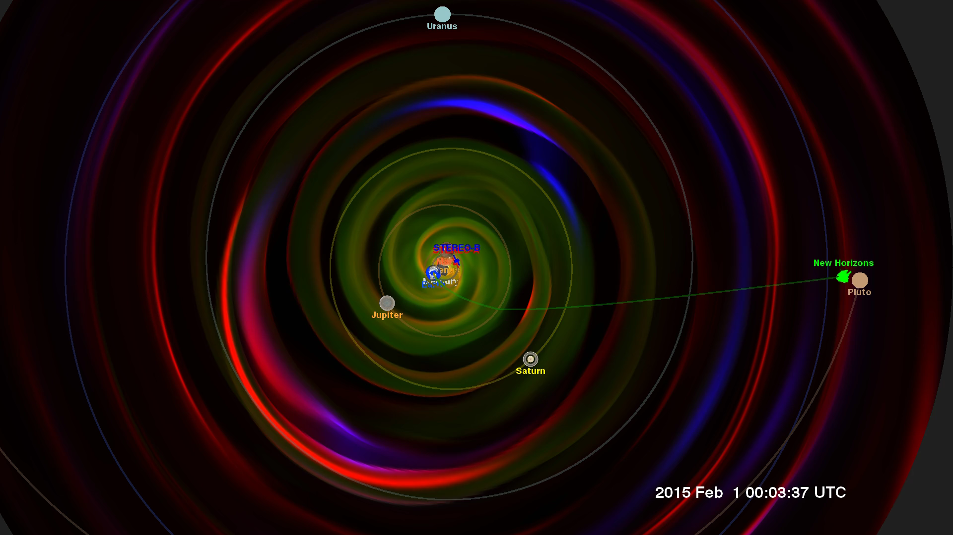
Notes:
Everyone likes to check the weather in a far away destination before they travel there. This is especially true for spaceflight, where the destination may be where no one has gone before.
The mission of New Horizons to Pluto provided an opportunity to test our current space weather models, pushing them to the limit. This visualization presents the results from an Enlil model run, just one of the many space weather models being tested through the Community-Coordinated Modeling Center (CCMC) at NASA's Goddard Space Flight Center as part of the "New Horizons Flyby Modeling Challenge".
This visualization presents a slice of the data through the ecliptic plane, the plane in which the planets of our solar system orbit. Because Pluto is a bit above this plane, the orbit is projected into the ecliptic plane of the data, as is the trajectory of the New Horizons probe.
Three different variables are presented from the model - temperature, density, and pressure gradient, simultaneously, using the red, green and blue color channels of the color image. The density of the solar wind (green) flowing outward from the sun decreases as it spreads out. The temperature stays roughly constant as the solar wind material spreads through the solar system. We see the Parker spiral imprinted on the outflow from the spinning sun, much like the outflow from a spinning water sprinkler. We also see the strong density gradients (blue) created by coronal mass ejections and other shocks, propagating outward from the sun in the solar wind.
We can observe regions of interesting interactions when the three primary colors of the basic variables combine to enhance the color, represented in the tricolor diagram below. White represents a hot, dense shock, while cyan (blue-green) represents a dense shock (usually visible close to the sun), magenta (purple) represents a hot, low-density shock, while yellow indicates hot and dense material, again usually close to the sun.

