Slide 1
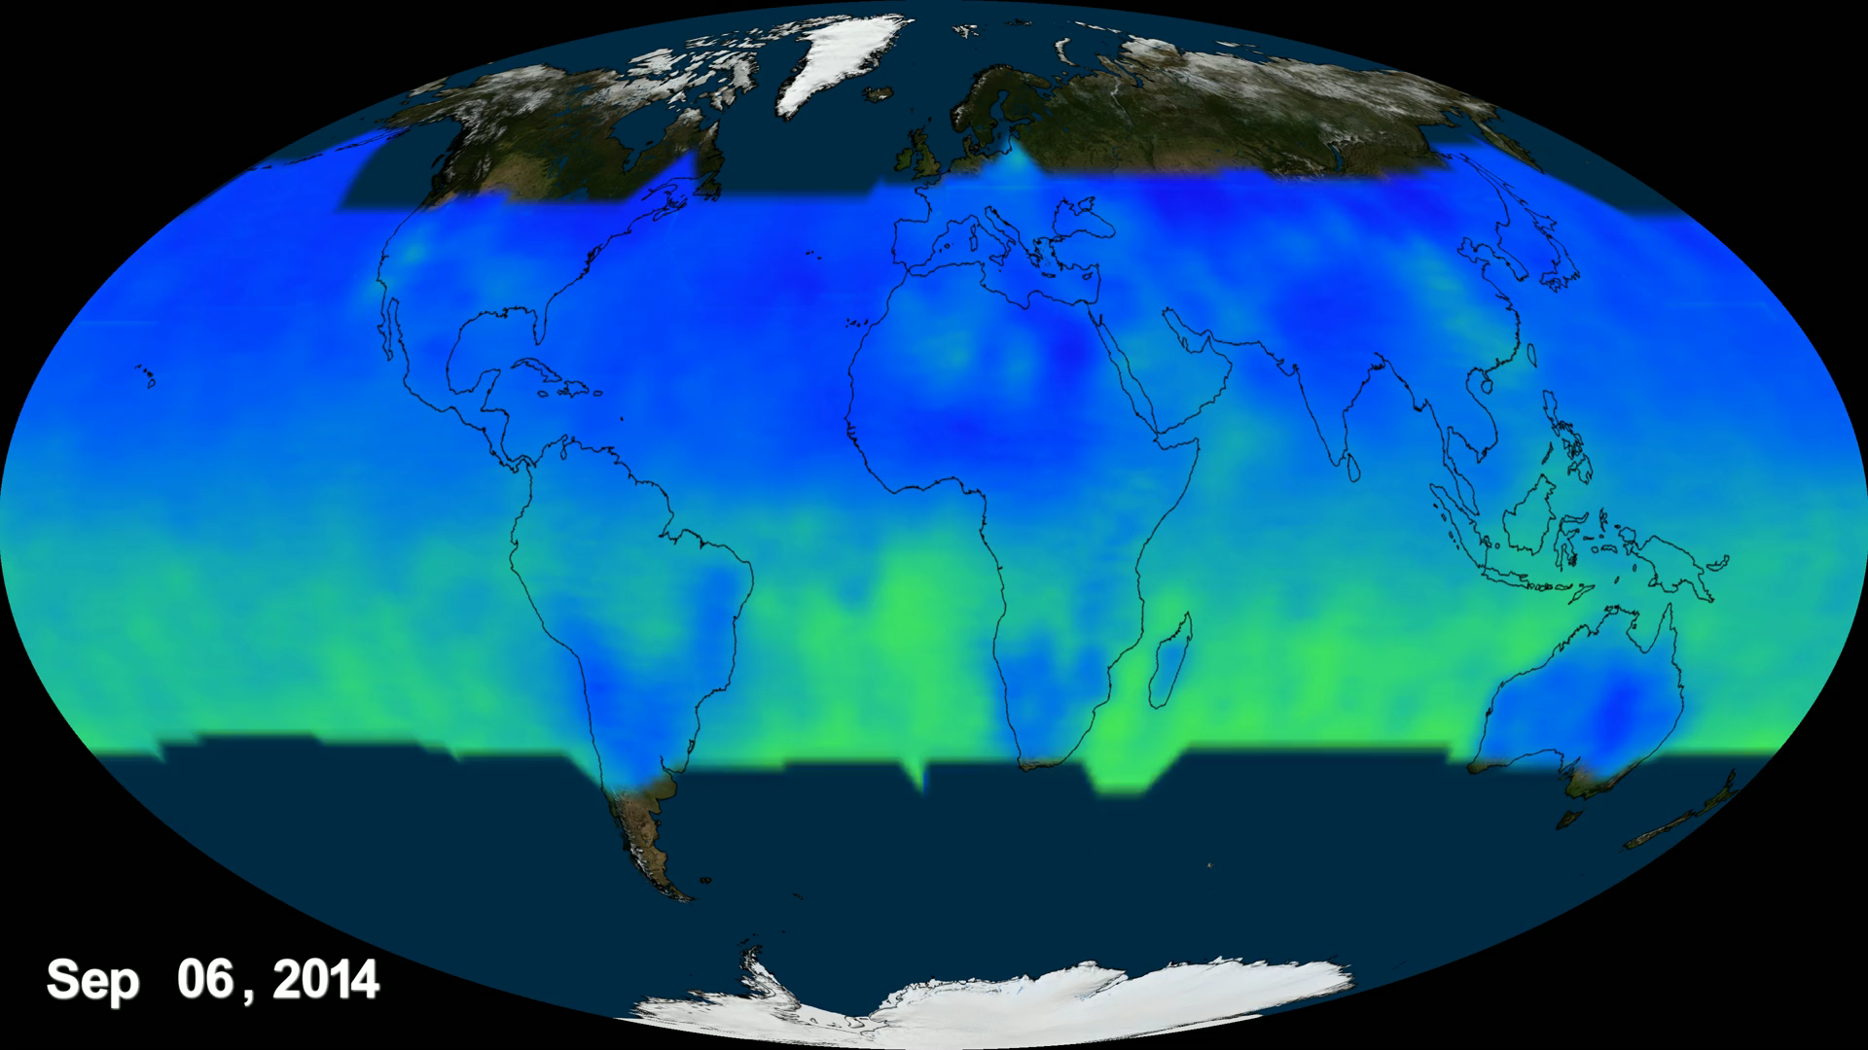
Notes:
Carbon dioxide is vital for life on Earth, but an overload of the greenhouse gas is driving one of the most serious problems facing our planet: climate change. With NASA's new experimental satellite, the Orbiting Carbon Observatory-2 (OCO-2) scientists now have a more complete picture of how Earth is changing as carbon dioxide levels rise.

