Slide 1
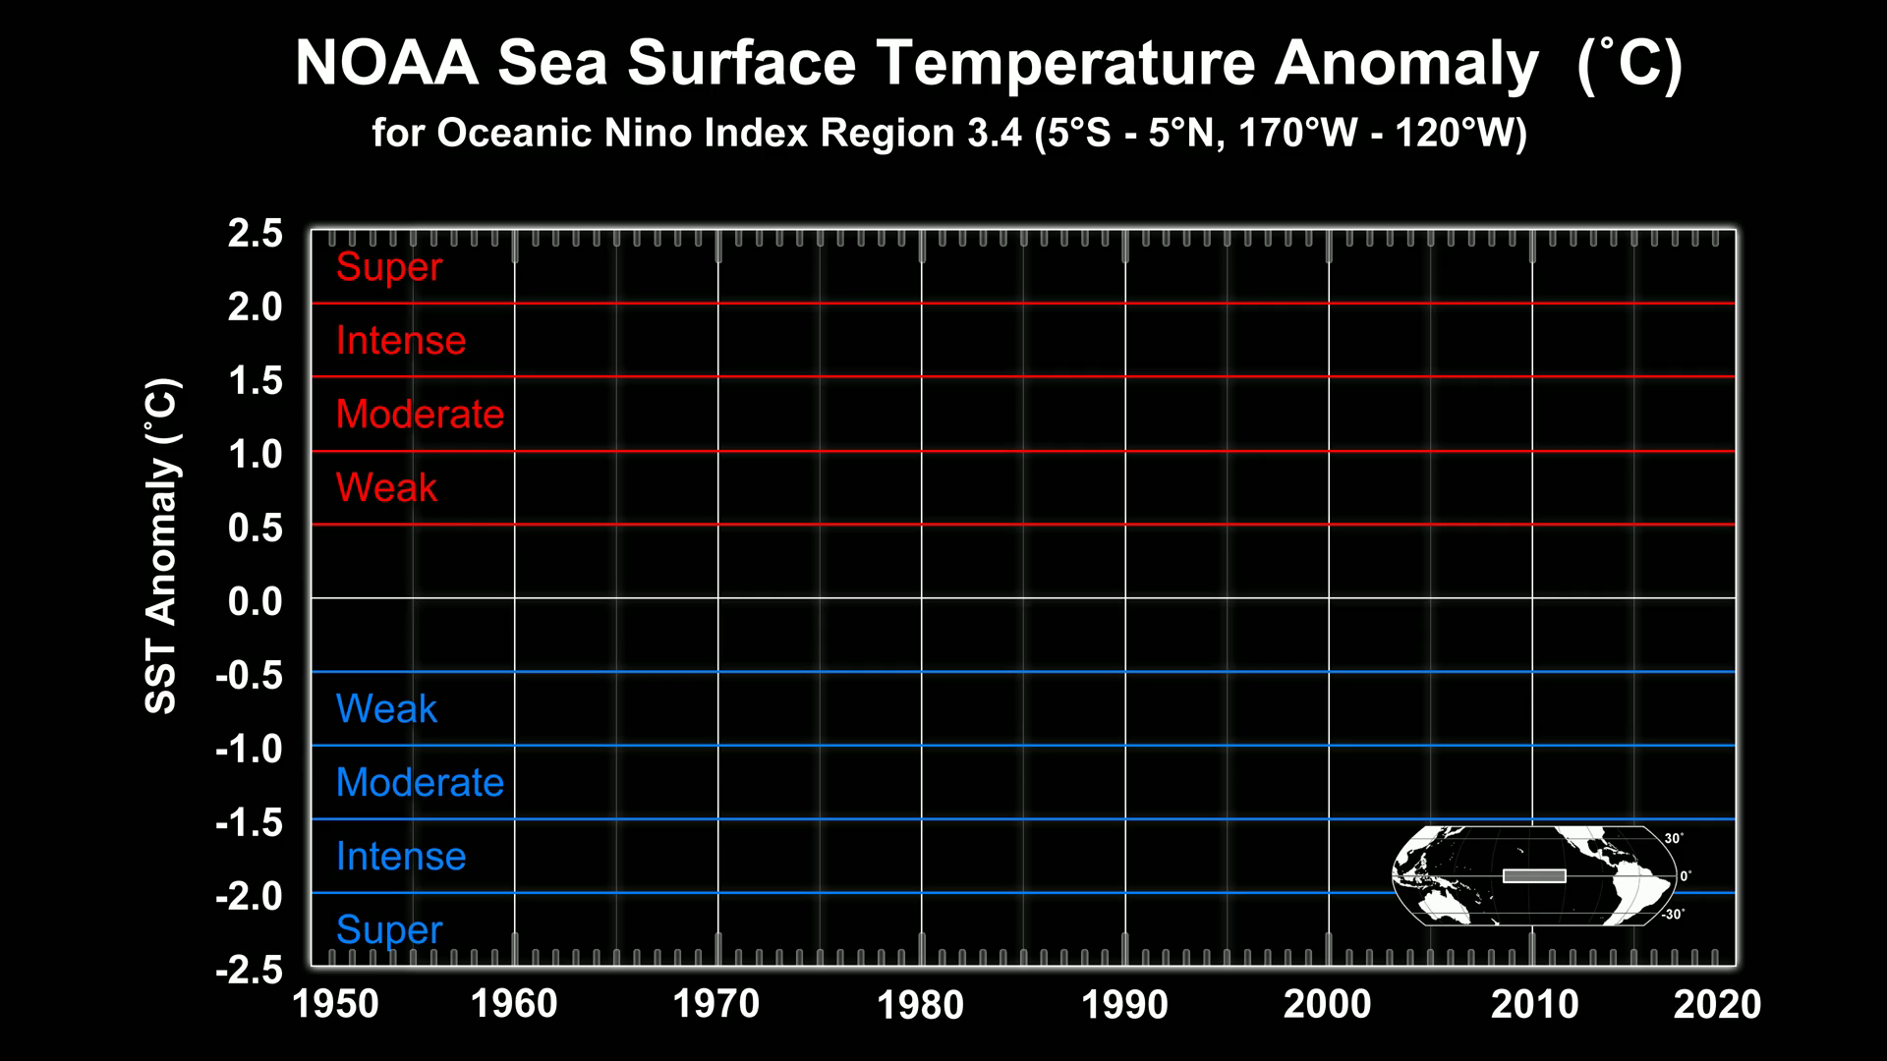
Notes:
Sea surface temperature anomalies (SSTA) from NOAA are used to determine when El Nino and La Nina conditions have occurred. This visualization shows a plot over time of SSTAs over a region of the Pacific Ocean called "Oceanic Nino Index Region 3.4". An El Nino happens when the SSTA is greater than 0.5 degrees C (shown in red); a La Nina happens when SSTA is less than -0.5 degrees C (shown in blue).
Over this period, several El Nino events occurred including: 1957-1958, 1972-1973, 1982-1983, and 1997-1998.
This visualization is based on the following NOAA data:
http://www.cpc.ncep.noaa.gov/products/analysis_monitoring/ensostuff/ensoyears.shtml

