Slide 1
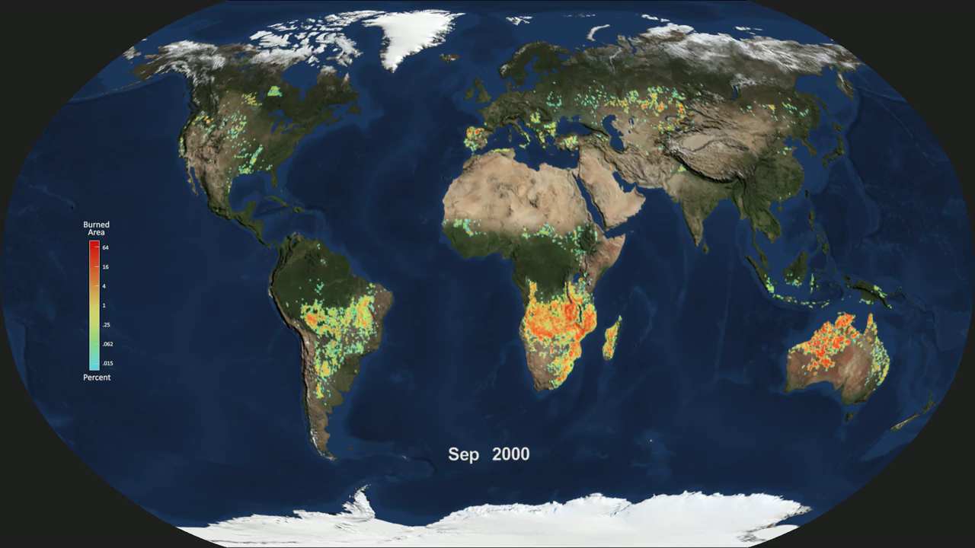
Notes:
Global Monthly Burned Area
This time series was created using data from the Moderate Resolution Imaging Spectrometer (MODIS) onboard NASA’s Terra and Aqua satellites. Burned area is estimated by applying an algorithm that detects rapid changes in visible and infrared surface reflectance imagery. Fires typically darken the surface in the visible part of the electromagnetic spectrum, and brighten the surface in several wavelength bands in the shortwave infrared that are sensitive to the surface water content of vegetation. Thermal emissions from actively burning fires also are measured by MODIS and are used to improve the burned area estimates in croplands and other areas where the fire sizes are relatively small.
This animation portrays burned area between September 2000 and August 2015 as a percent of the 1/4 degree grid cell that was burned each month. The values on the color bar are on a log scale, so the regions shown in blue and green shades indicate small burned areas while those in red and orange represent a larger percent of the region burned. Beneath the burned area, the seasonal Blue Marble landcover shows the advance and retreat of snow in the northern hemisphere.
For more information, visit
www.globalfiredata.org

