Slide 1
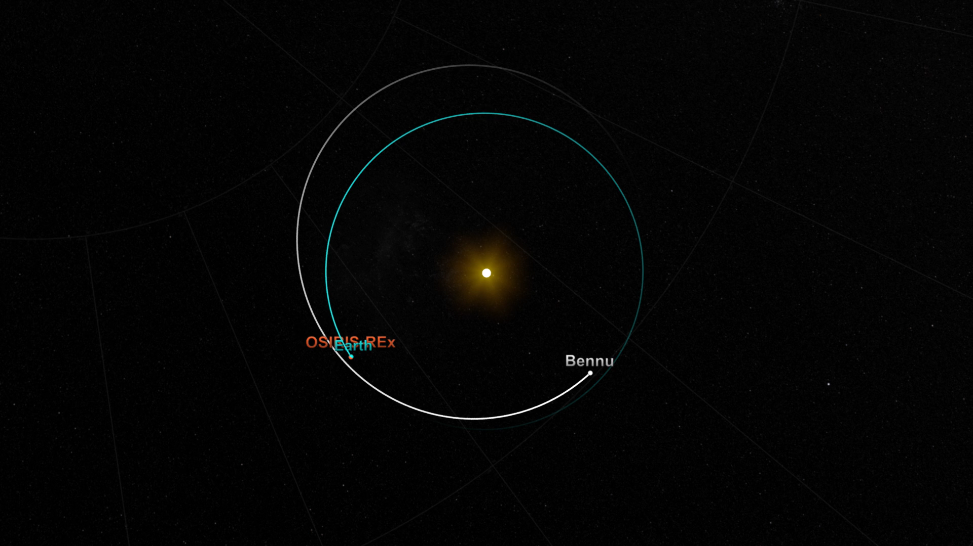
Notes:
OSIRIS-REx Mapping Bennu Close-up
The Origins Spectral Interpretation Resource Identification Security - Regolith Explorer spacecraft will travel to a near-Earth asteroid, called Bennu (formerly 1999 RQ36), and bring at least a 2.1-ounce sample back to Earth for study. The mission will help scientists investigate how planets formed and how life began, as well as improve our understanding of asteroids that could impact Earth.
OSIRIS-REx launched on Sept. 8, 2016, at 7:05 p.m. EDT. As planned, the spacecraft will reach its target asteroid in 2018 and return a sample to Earth in 2023. These animations depict the journey of OSIRIS-REx to Bennu and back, including the complex maneuvers that the spacecraft will perform in the asteroid's low-gravity environment.
For more information, visit:
svs.gsfc.nasa.gov/4482

