Slide 1
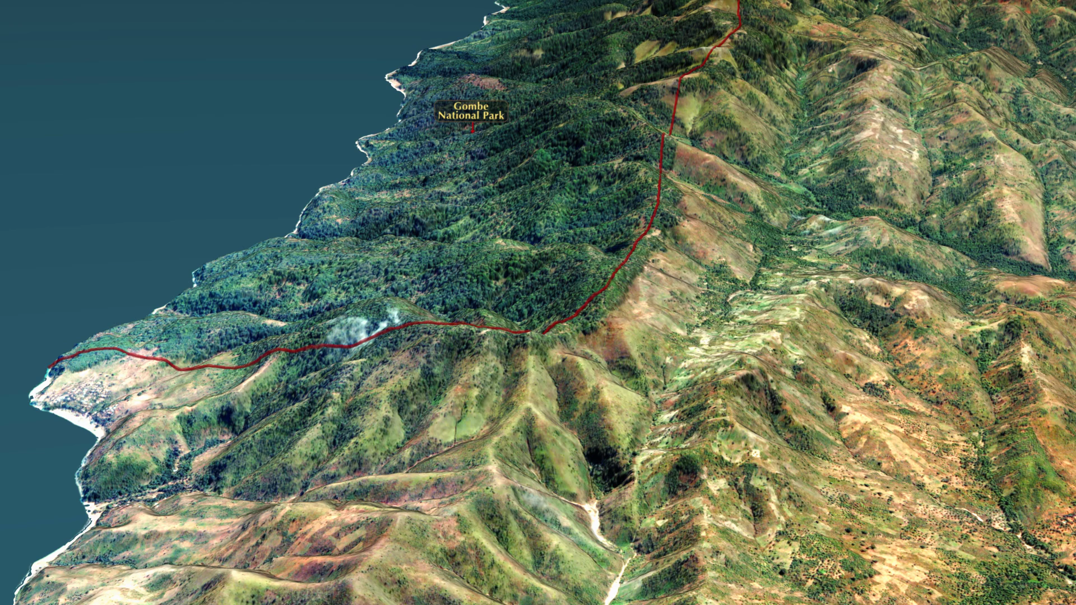
Notes:
Monitoring Chimpanzee Habitats in Western Tanzania
In partnership with the Jane Goodall Institute (JGI), NASA scientists have provided assistance in the monitoring, forecasting, and conservation of natural resources in regions surrounding the Gombe National Park in Tanzania. Between 1972 and 1999, significant deforestation had occurred in the regions outside the boundary of the Gombe National Park to the detriment of the park's chimpanzee population as well as to the that of the villagers living in the region.
This visualization shows the difference in the forest cover between the region within the Gombe National Park, to the left of the red boundary line, and the regions outside of the park to the right. In 2005, JGI initiated a forest monitoring program training and in 2009 equipped community members with GPS-enabled Android smart phones and tablets to report their observations on forests threats and wildlife. Combining NASA remote sensing data with citizen science observations facilitated local people to develop and implement land use plans, leading to improved decision making and facilitating the establishment of village forest reserves.
For more information, visit:
http://svs.gsfc.nasa.gov/4483

