Slide 1
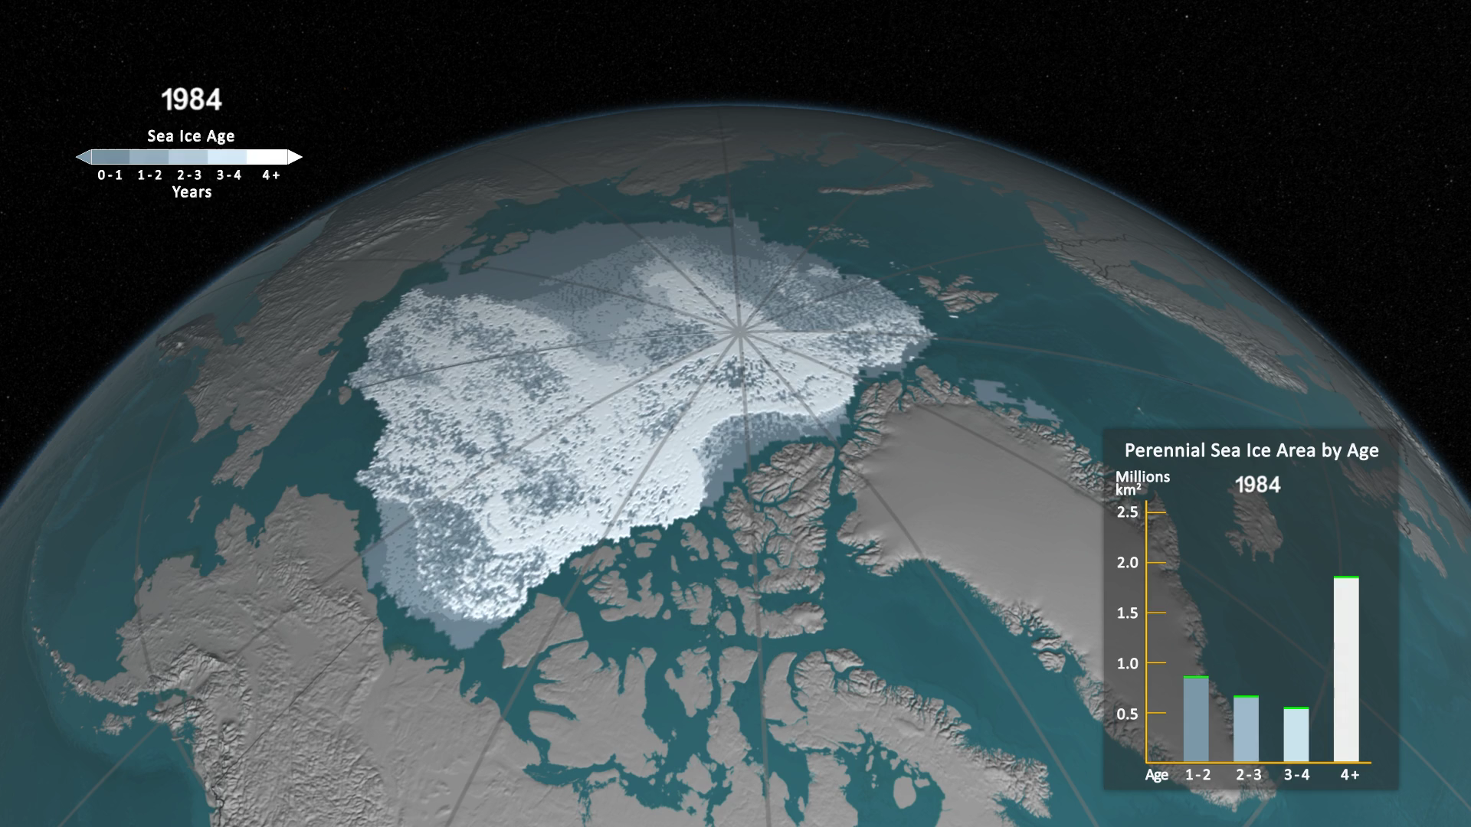
Notes:
One significant change in the Arctic region in recent years has been the rapid decline in perennial sea ice. Perennial sea ice, also known as multi-year ice, is the portion of the sea ice that survives the summer melt season. Perennial ice may have a life-span of nine years or more and represents the thickest component of the sea ice; perennial ice can grow up to four meters thick. By contrast, first year ice that grows during a single winter is generally at most two meters thick.
This animation shows the Arctic sea ice age for the week of the minimum ice extent for each year, depicting the age in different colors. Younger sea ice, or first-year ice, is shown in a dark shade of blue while the ice that is four years old or older is shown as white. A color scale identifies the age of the intermediary years.
Correction: The original release on 10/28/2016 incorrectly labeled the oldest category on the graph as "5+". This was corrected to read "4+" on 10/30/2016.

