Slide 1
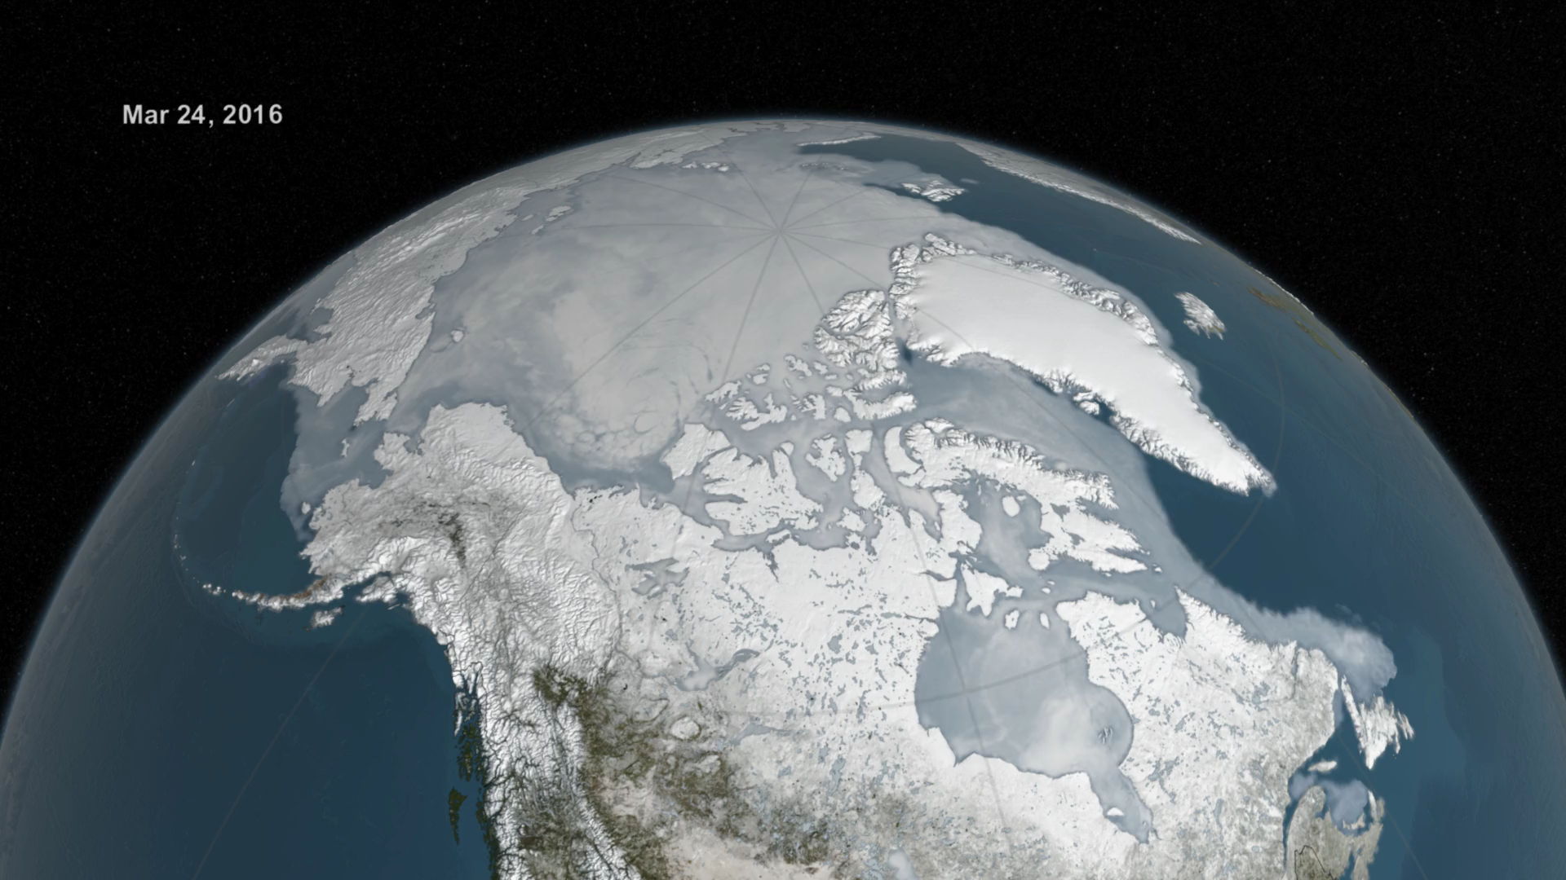
Notes:
Arctic Sea Ice from March to September 2016
The Japan Aerospace Exploration Agency (JAXA) provides many water-related products derived from data acquired by the Advanced Microwave Scanning Radiometer 2 (AMSR2) instrument aboard the Global Change Observation Mission 1st-Water "SHIZUKU" (GCOM-W1) satellite. Two JAXA datasets used in this animation are the 10-km daily sea ice concentration and the 10 km daily 89 GHz Brightness Temperature.
In this animation, the daily Arctic sea ice and seasonal land cover change progress through time, from the prior sea ice maximum on March 24, 2016, through September 10, 2016 when the sea ice reached its annual minimum extent. Over the water, Arctic sea ice changes from day to day showing a running 3-day minimum sea ice concentration in the region where the concentration is greater than 15%. The blueish white color of the sea ice is derived from a 3-day running minimum of the AMSR2 89 GHz brightness temperature. Over the terrain, monthly data from the seasonal Blue Marble Next Generation fades slowly from month to month.
For more information:
svs.gsfc.nasa.gov/4494

