Slide 1
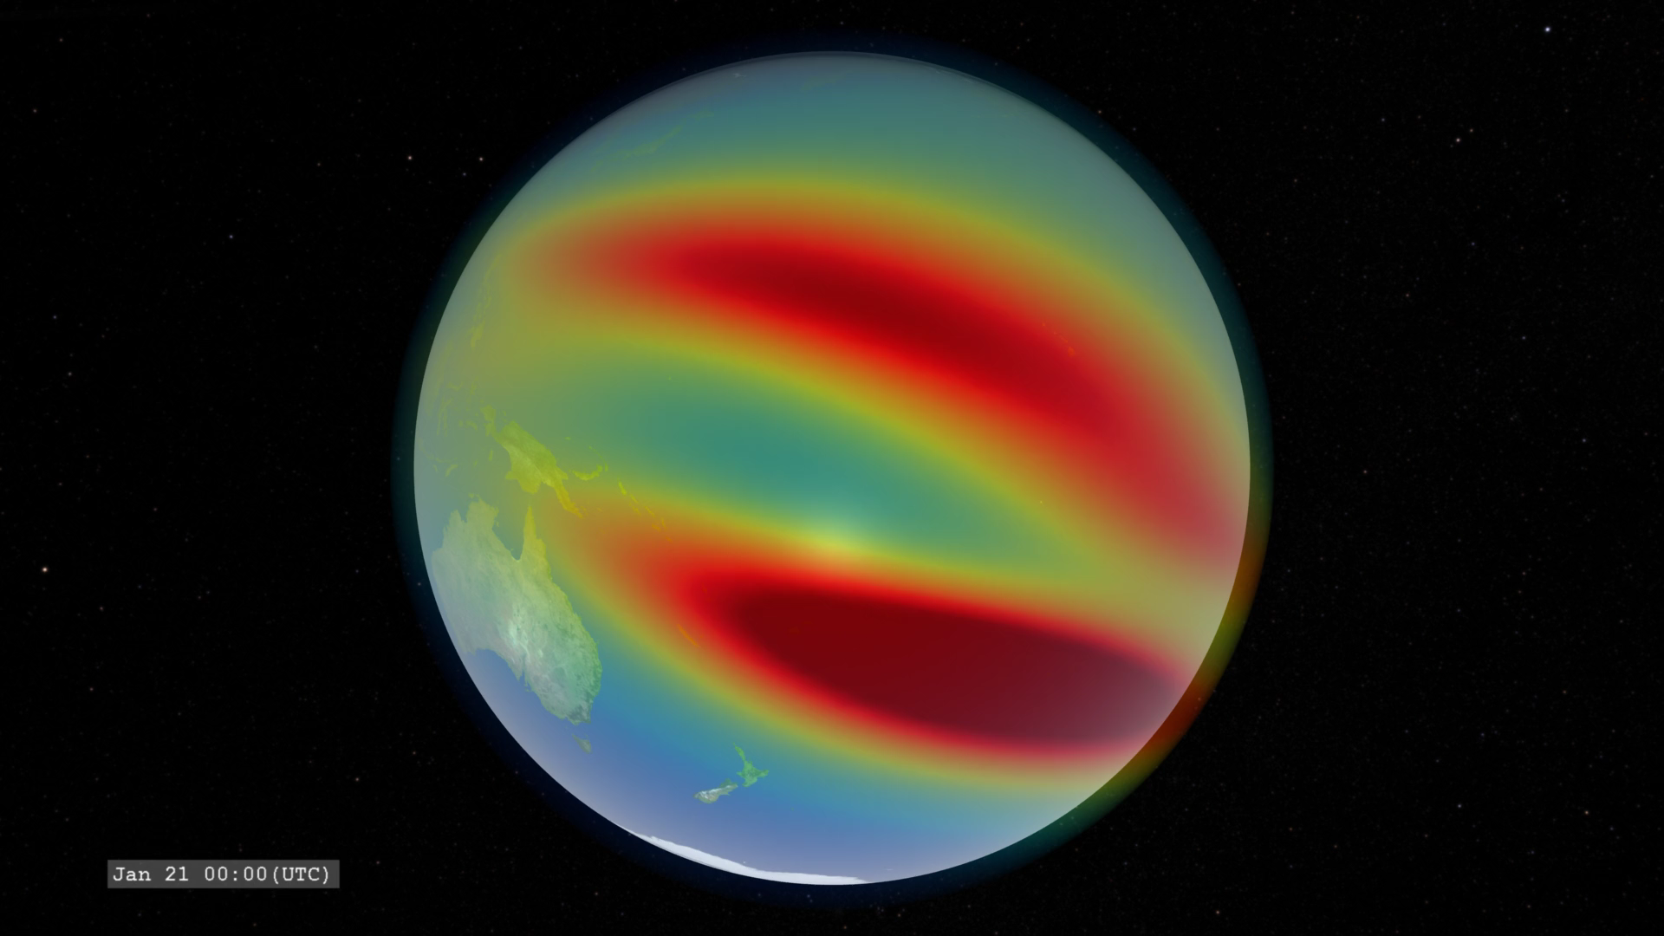
Notes:
The colors over Earth represent model data from the IRI (International Reference Ionosphere) model of the density of the singly-ionized oxygen atom at an altitude of 350 kilometers. Red represents high density. The ion density is enhanced above and below the geomagnetic equator (not perfectly aligned with the geographic equator) on the dayside due to the ionizing effects of solar ultraviolet radiation combined with the effects of high-altitude winds and the geomagnetic field. This ion density decreases at night as the ions recombine with free electrons.

