Slide 1
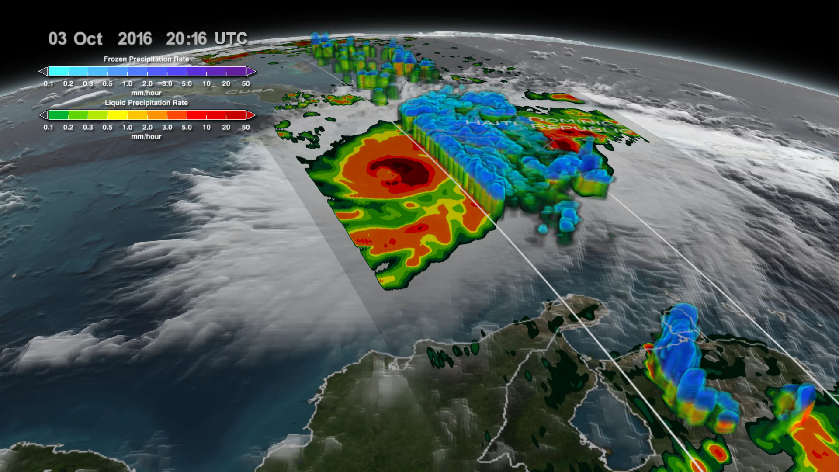
Notes:
GPM Monitors Hurricane Matthew Nearing Florida
In 2016, Hurricane Matthew was a very powerful, long-lived and deadly tropical cyclone that became the first Category 5 Atlantic hurricane since Hurricane Felix in 2007. The storm travelled across the Western Atlantic, including parts of Haiti, Cuba, Dominican Republic and Lucayan Archipelago, the southeastern United States, and the Canadian Maritimes.
NASA's Global Precipitation Measurement (GPM) Core Observatory flew over Hurricane Matthew several times as the Category 4 storm headed toward Florida. This data visualization shows the storm on October 4, 2016, as the eye makes landfall over Haiti. Data from GPM show the tremendous amounts of rainfall throughout Haiti. On October 6, as Matthew approaches Florida, another swath of data from GPM shows how close the outer bands of precipitation are to the Florida coast. Finally, the massive amounts of rainfall being produced by this storm as it begins to impact Florida are shown. The GPM mission is helping to advance our understanding of Earth's water and energy cycle, improve forecasting of extreme events that cause natural hazards and disasters, and extend current capabilities in using accurate and timely information of precipitation to directly benefit society.
For more information, visit:
svs.gsfc.nasa.gov/4511

