Slide 1
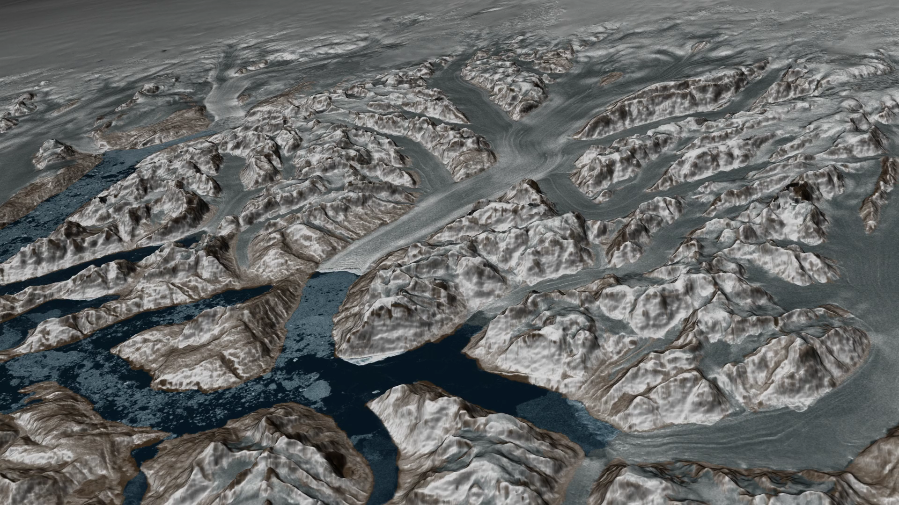
Notes:
Seasonal Speed Variation on Heimdal Glacier
By tracking displacement of local surface features in LandSat imagery on outlet glaciers multiple times per year, researchers have been able to show that each glacier around Greenland has a unique pattern of flow variation through the seasons. These seasonal variations, seen in this animation on the lower 25 kilometers of Heimdal Glacier in southeast Greenland, are caused by a combination of processes. By measuring these changes in flow on seasonal timescales, scientists can develop a better understanding of what controls the flow of these glaciers where they meet the ocean. This understanding will improve our ability to anticipate flow responses of these systems in a warming climate.

