Slide 1
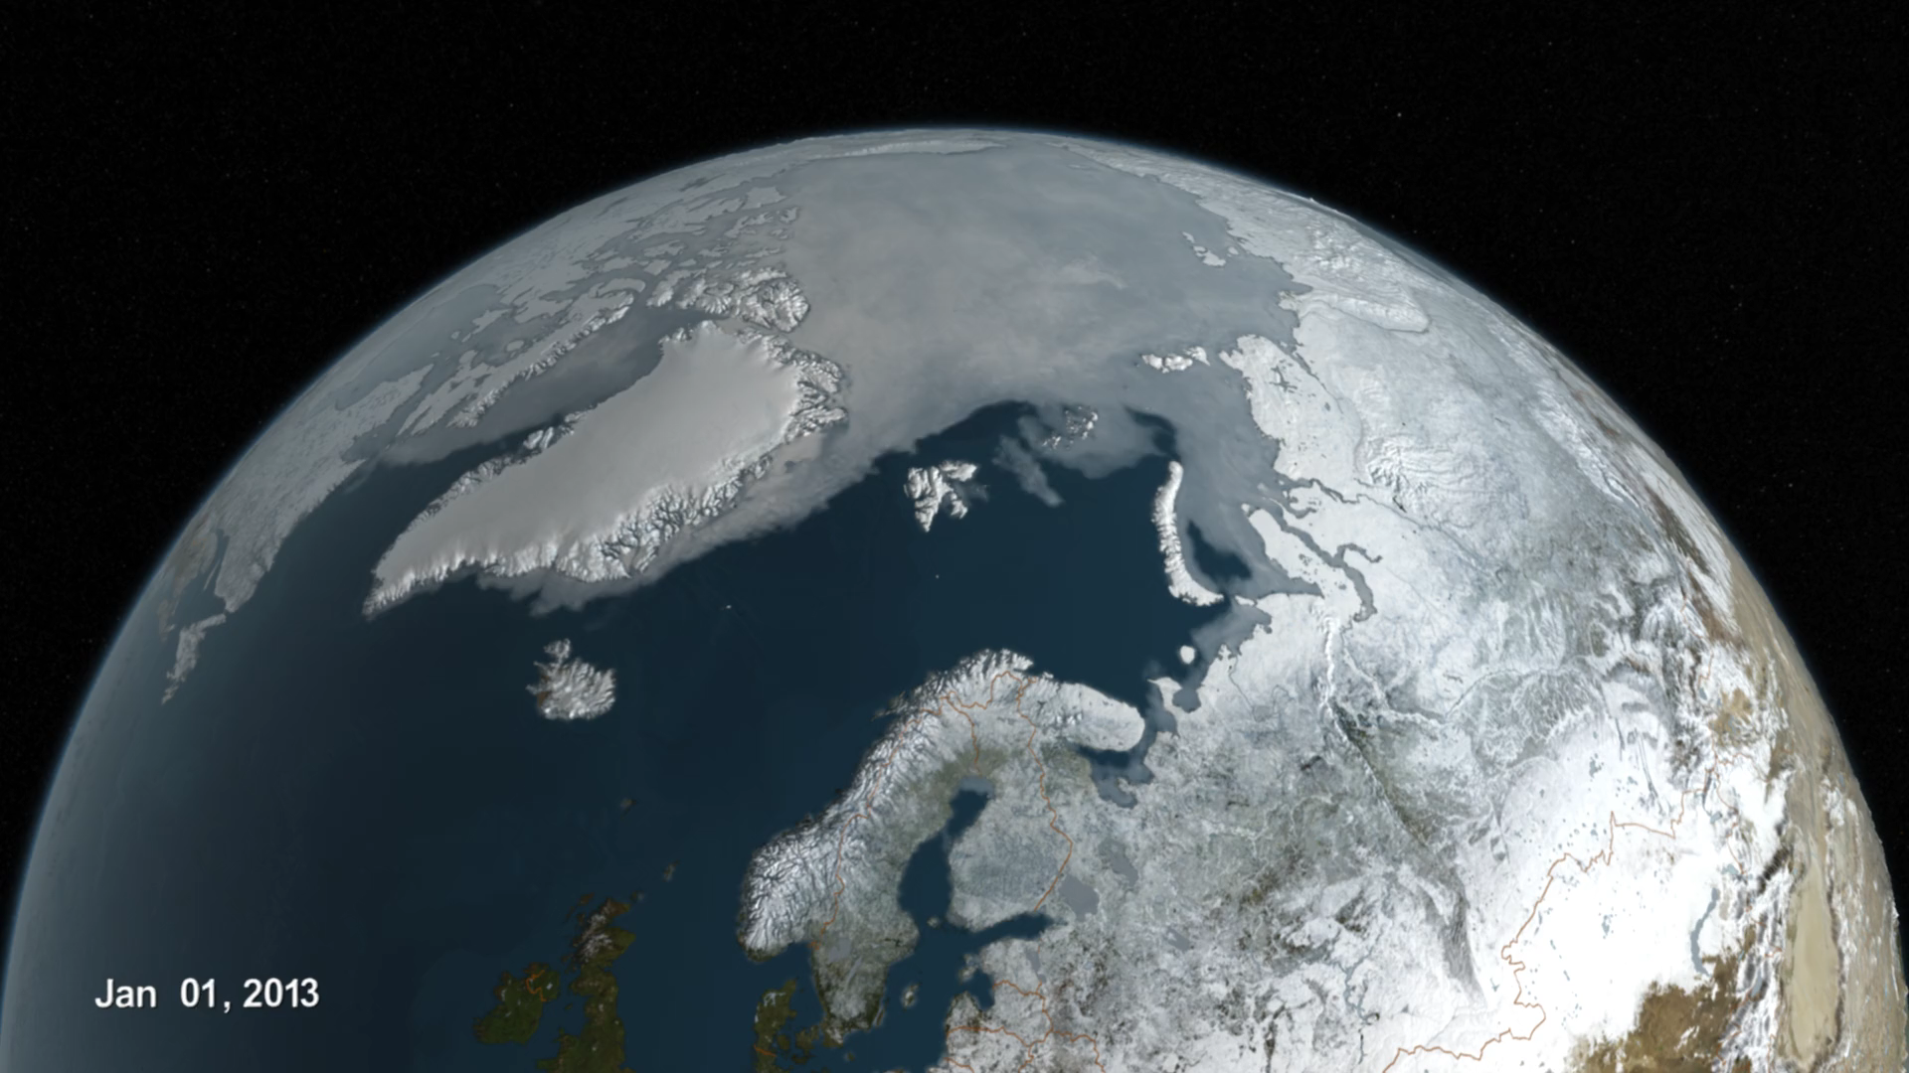
Notes:
Arctic Sea Ice from
Jan 1, 2013 to Sept 10, 2016
The first six months of 2016 have been the warmest first half of any year in our recorded history of surface temperature (which go back to 1880). Data shows that the Arctic temperature increases are much bigger, relatively, than the rest of the globe.
This visualization shows the daily Arctic sea ice and seasonal land cover change progressing through time, from January 1, 2016, through September 10, 2016 when the sea ice reached its annual minimum extent for 2016.

