Slide 1
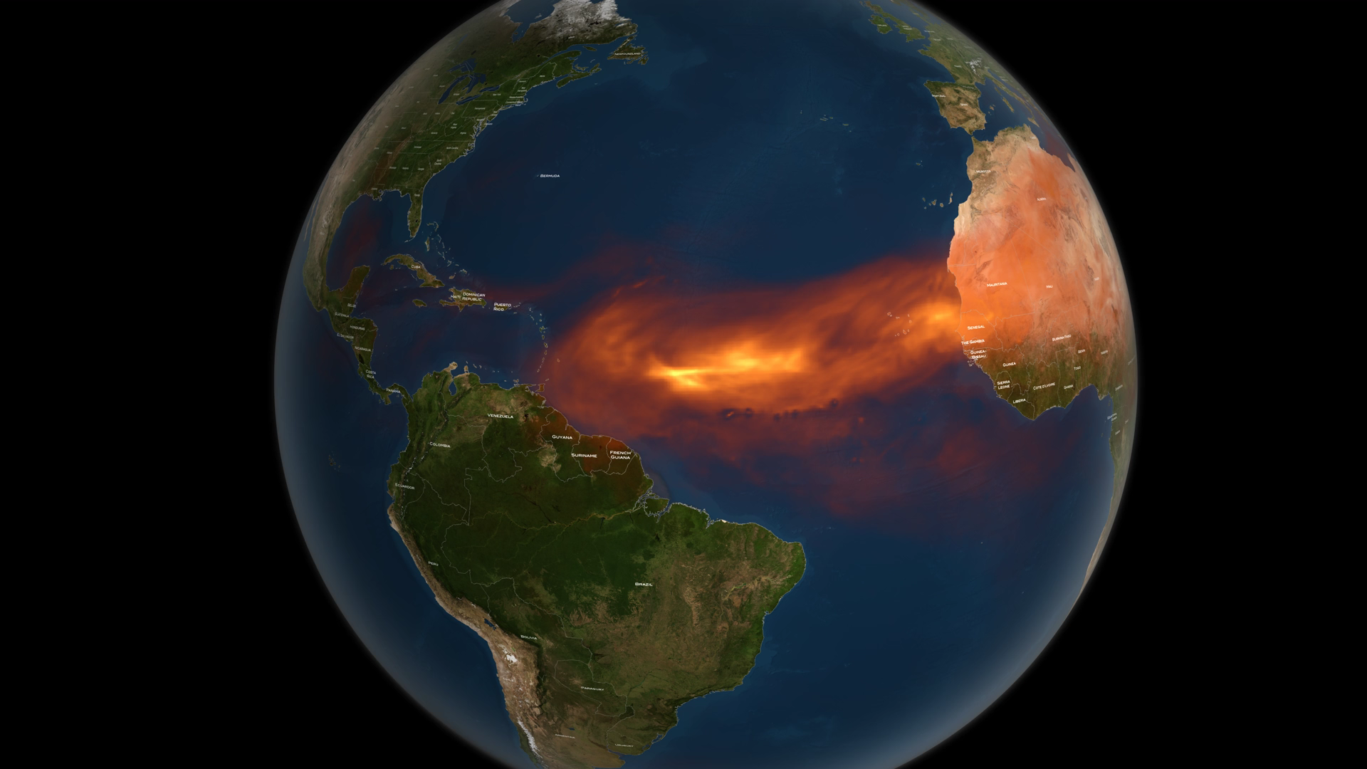
Notes:
CATS Observes African Dust
NASA’s Cloud-Aerosol Transport System, or CATS, is a lidar remote-sensing instrument taking measurements of atmospheric aerosols and clouds from the International Space Station (ISS). The CATS mission, launched to the ISS in January 2015, extends the data record of space-based aerosol and cloud measurements to ensure the continuity of lidar climate observation.
In this visualization, CATS (onboard the ISS) passes over a dust cloud leaving Africa. Data from CATS provide a vertical profile of the atmosphere. Such “slices” of data (called attenuated backscatter data) allow you to see the relative height of the clouds and aerosols (such as dust), among other properties (e.g., layer thickness and optical depth). To do this, the CATS instrument uses different wavelengths that reflect differently when they hit aerosols. By comparing the returns from multiple wavelengths, the scientists can distinguish dust from ice, smoke, or other airborne particles. Shown here, particles over northern Africa—likely dust kicked up by Saharan windstorms—reach heights of 2.5 to 3 miles (4 to 5 kilometers). Data from CATS will help scientists model the structure of dust plumes and other atmospheric features, which can travel far distances and impact air quality. Climate scientists will also use the CATS data, along with data from other Earth-observing instruments, to look at trends and interactions in clouds and aerosols over time.
For more information, visit
http://svs.gsfc.nasa.gov/4542

