Slide 1
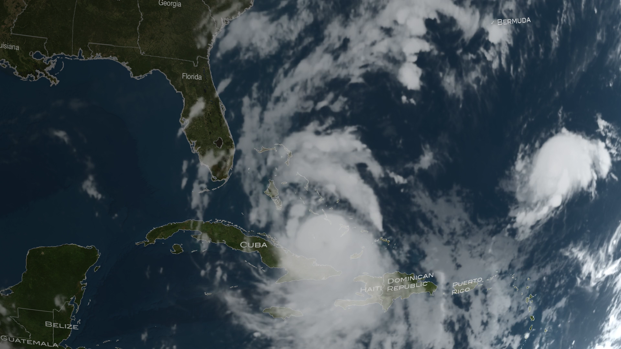
Notes:
CATS Observes Hurricane Matthew
NASA’s Cloud-Aerosol Transport System, or CATS, is a lidar remote-sensing instrument taking measurements of atmospheric aerosols and clouds from the International Space Station (ISS). The CATS mission, launched to the ISS in January 2015, extends the data record of space-based aerosol and cloud measurements to ensure the continuity of lidar climate observation.
Measurements from CATS at different local times over the tropics and mid-latitudes provide comprehensive spatial and temporal coverage of clouds associated with mid-latitude storms and convective systems. Shown here, CATS (onboard the ISS) observed outflow anvil cirrus and convective clouds near the core of Hurricane Matthew, which wreaked havoc on the Southeast U.S. and Caribbean in October 2016. Data from CATS provide a vertical profile of the atmosphere. Such “slices” of data (called attenuated backscatter data) allow you to see the relative height of the clouds and aerosols in the atmosphere, among other properties (e.g., layer thickness and optical depth).
For more information, visit
http://svs.gsfc.nasa.gov/4542

