Slide 1
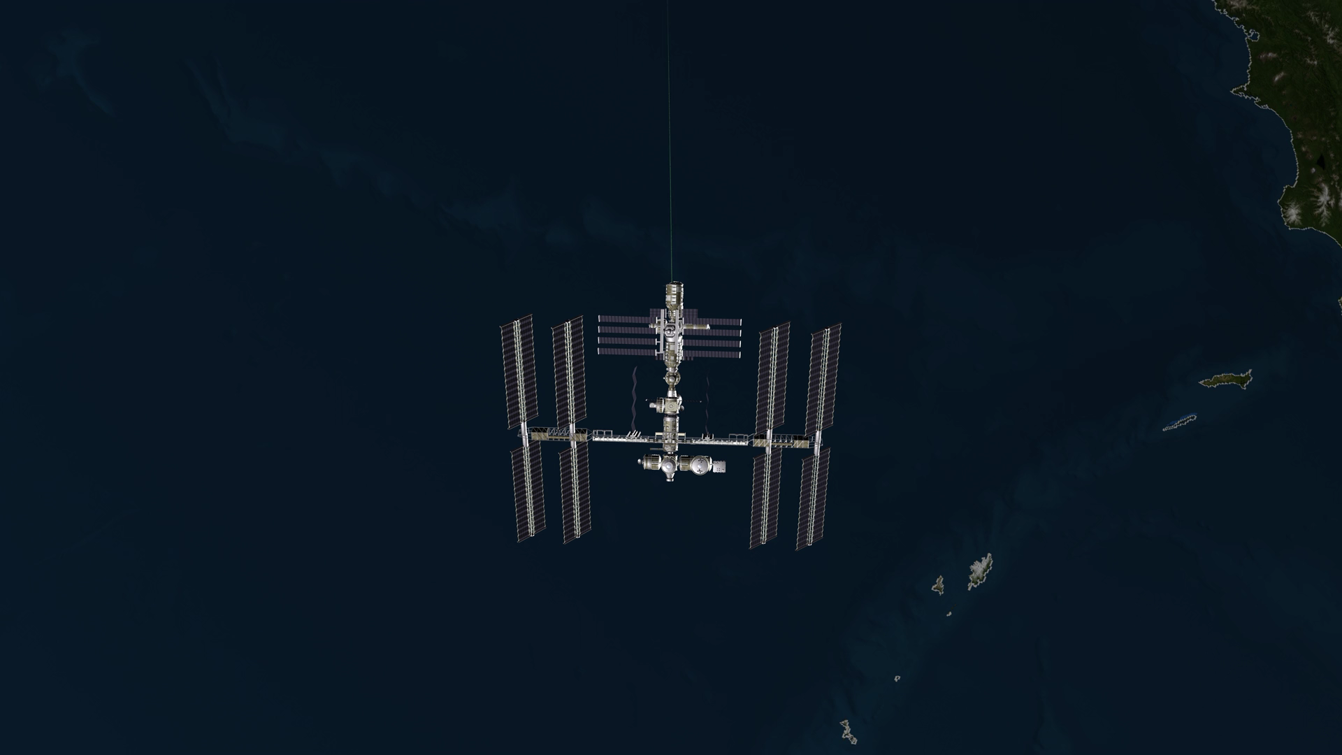
Notes:
CATS Observes Smoke from Oregon Wildfires
NASA’s Cloud-Aerosol Transport System, or CATS, is a lidar remote-sensing instrument taking measurements of atmospheric aerosols and clouds from the International Space Station (ISS). The CATS mission, launched to the ISS in January 2015, extends the data record of space-based aerosol and cloud measurements to ensure the continuity of lidar climate observation. In this visualization, CATS (onboard the ISS) passes over a plume of smoke from wildfires in Oregon, August 18, 2015. Data from CATS provide a vertical profile of the atmosphere. Such “slices” of data (called attenuated backscatter data) allow you to see the relative height of the smoke plume, among other properties (e.g., layer thickness and optical depth). CATS has demonstrated the ability to detect the vertical structure of smoke plumes within an unprecedented 6 hour window of data collection.
Scientists get a broad picture of air quality conditions in the atmosphere and generate air quality forecasts by combining satellite, aircraft, and ground-based data with sophisticated computer models. However, most datasets do not provide information about the vertical structure of clouds and aerosols and their layer type. Incorporating the near real-time vertical data that CATS produces is expected to improve our ability to track different cloud and aerosol types at all layers of the atmosphere. These datasets will be used to improve strategic and hazard-warning capabilities of events in near real-time (e.g., plume tracking for dust storms, volcanic eruptions, and wild fires), which ultimately impact our daily lives.
For more information, visit
http://svs.gsfc.nasa.gov/4542

