Slide 1
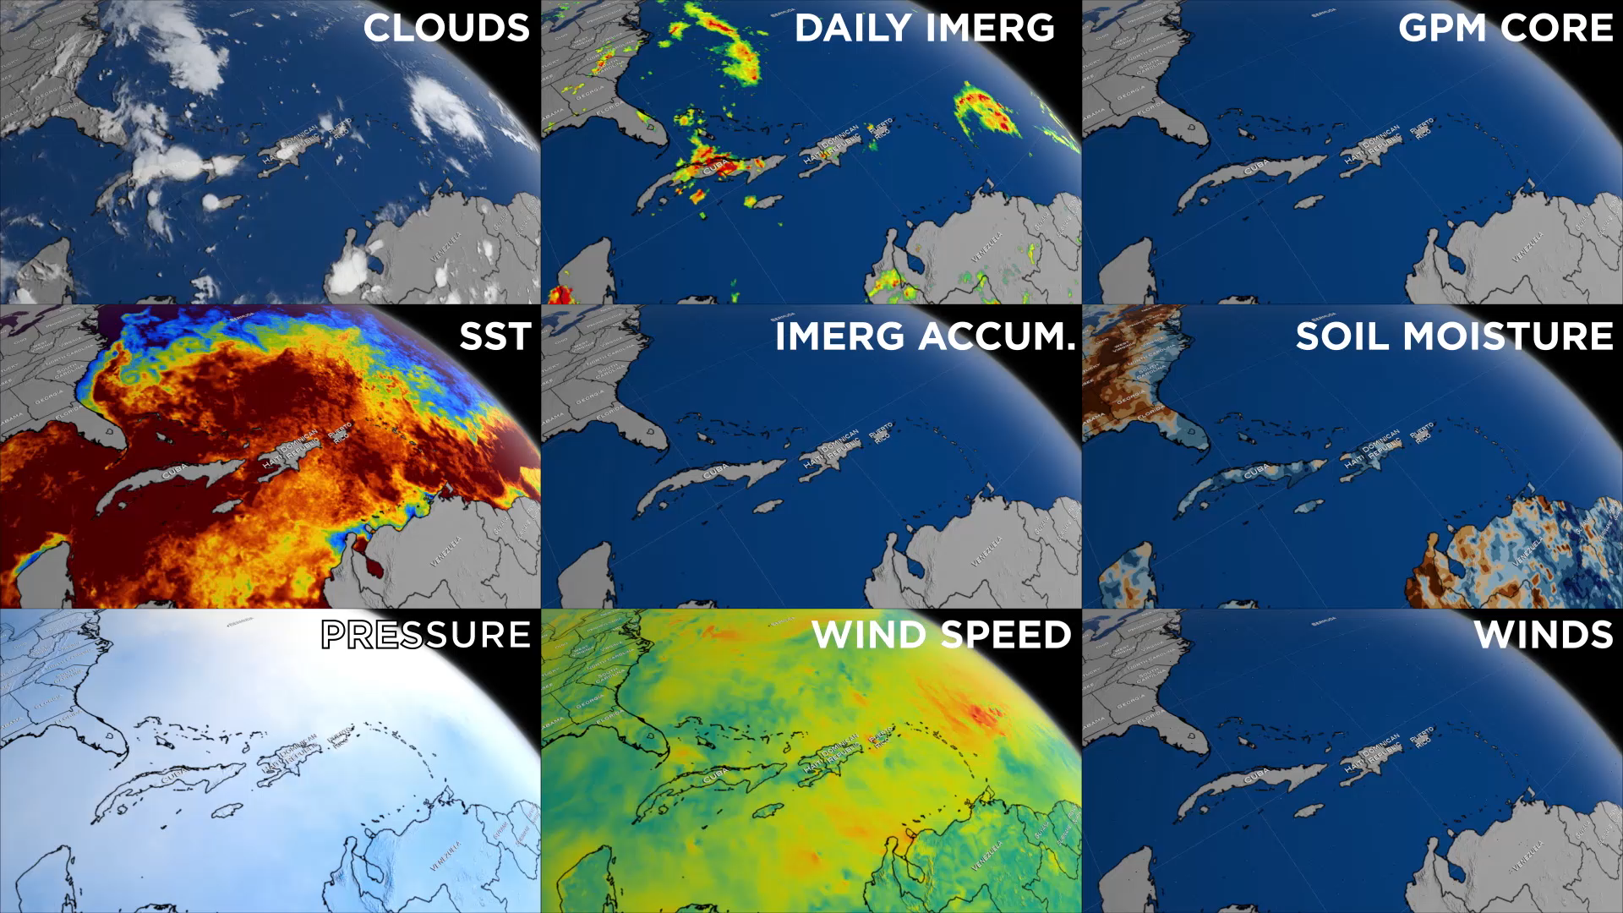
Notes:
Digging into Hurricane Matthew
Hurricane Matthew was the strongest tropical system in the Atlantic basin in 2016. The red line shows the “best track” of the center with the category number plotted twice a day. This display shows Matthew’s structure using infrared-based clouds (top left), overpasses of the GPM Core Observatory satellite (top right), the GPM IMERG multi-satellite precipitation (top), and a running accumulation of IMERG (center). In addition, Matthew decreased sea surface temperature (left) along its track, particularly where its forward speed slowed, and soil moisture (right) increased where heavy rain occurred. Some parameters are not observable from space, so numerical models provide surface pressure (bottom left), surface wind speed (bottom), and 3-D wind vectors (bottom right; brighter vectors are lower in altitude). Wind speed is generally greater on the right-hand side of the storm, and land tends to reduce wind speeds dramatically.
It is fascinating to see how surface pressure and wind speed relate to the cloud tops. Precipitation varies tremendously over time, frequently lacking the classic eyewall we expect, but the clouds, pressure, wind speed, and 3-D wind vectors clearly resolve this feature.
For more information: svs.gsfc.nasa.gov/4543

