Slide 1
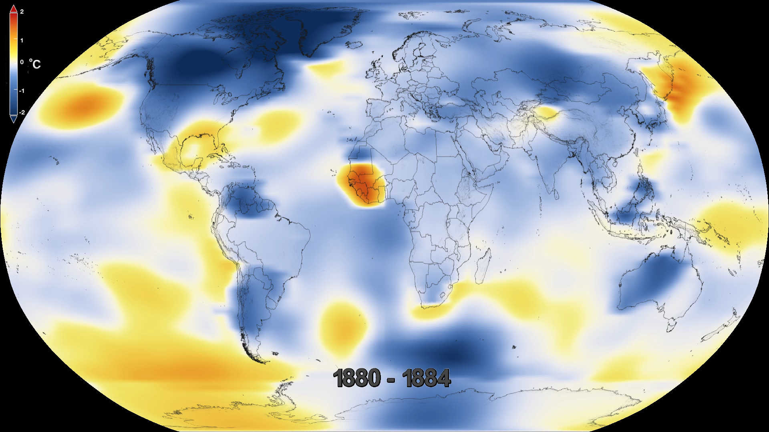
Notes:
Five-Year Global Temperature Anomalies from 1880 to 2016
Earth’s 2016 surface temperatures were the warmest since modern recordkeeping began in 1880, according to independent analyses by NASA and the National Oceanic and Atmospheric Administration (NOAA). Globally-averaged temperatures in 2016 were 1.78 degrees Fahrenheit (0.99 degrees Celsius) warmer than the mid-twentieth century mean. This makes 2016 the third year in a row to set a new record for global average surface temperatures.
The 2016 temperatures continue a long-term warming trend, according to analyses by scientists at NASA’s Goddard Institute for Space Studies (GISS). The planet’s average surface temperature has risen about 2.0 degrees Fahrenheit (1.1 degrees Celsius) since the late nineteenth century, a change driven largely by increased carbon dioxide and other human-made emissions into the atmosphere. Not only was 2016 the warmest year on record, but eight of the 12 months that make up the year—from January through September, with the exception of June—were the warmest on record for those respective months. A warming El Niño event was in effect for most of 2015 and the first third of 2016. Researchers estimate the direct impact of the natural El Niño warming in the tropical Pacific increased the annual global temperature anomaly for 2016 by 0.2 degrees Fahrenheit (0.12 degrees Celsius).
For more information, visit:
http://data.giss.nasa.gov/gistemp

