Slide 1
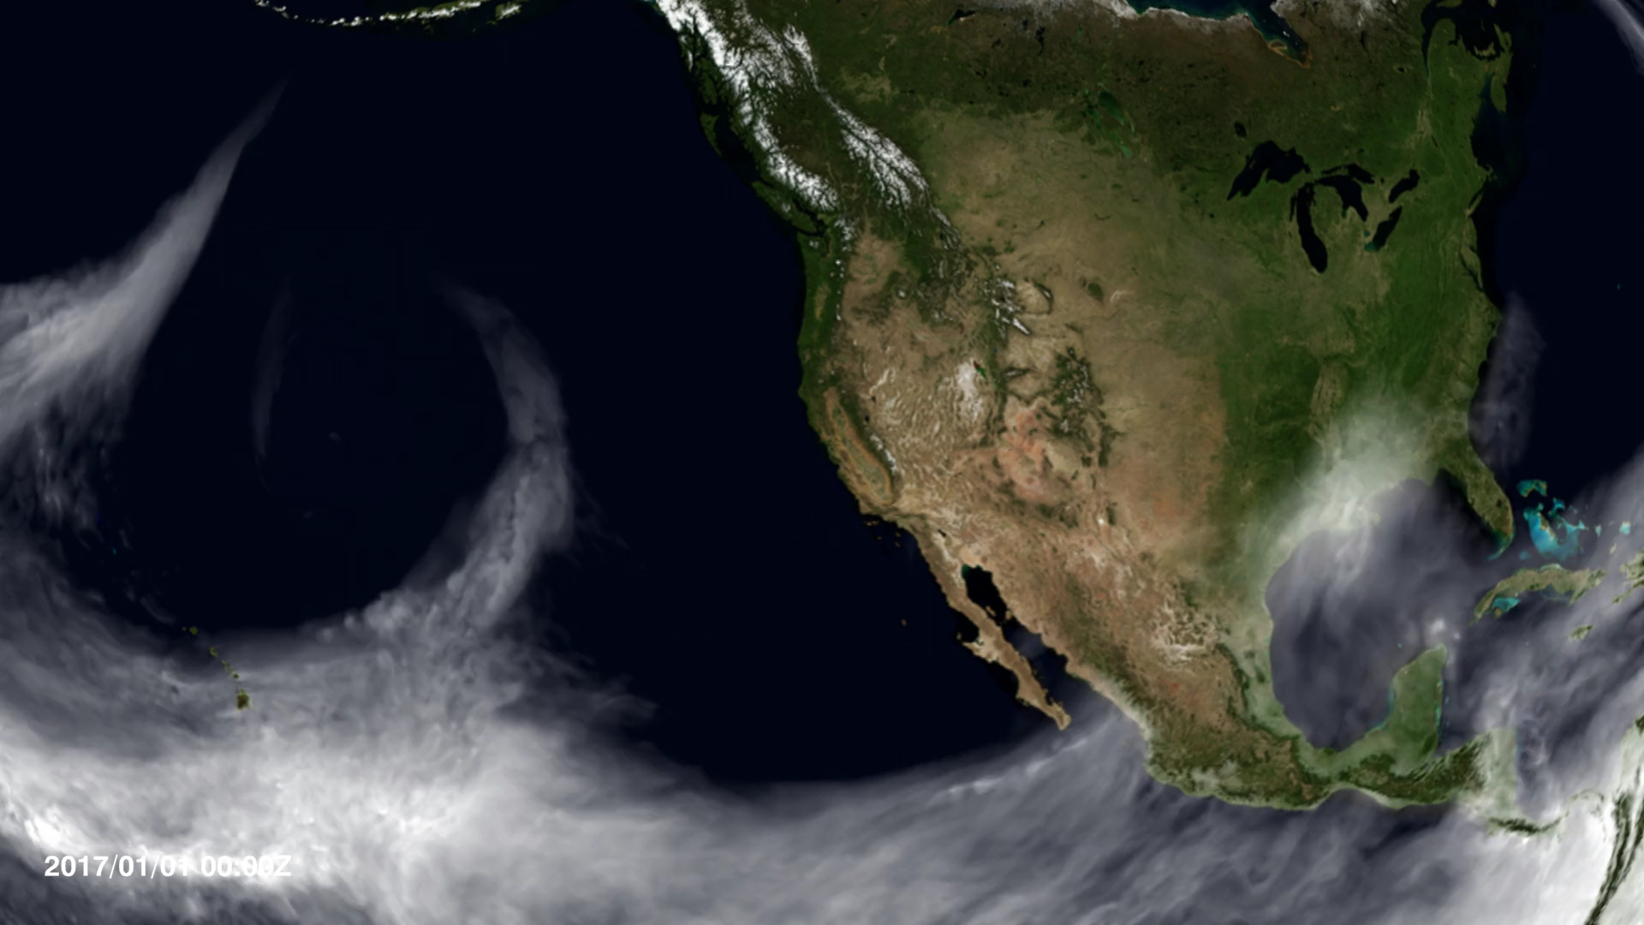
Notes:
Atmospheric River Slams California
After more than four years of drought, Californians may wonder where the current rain is coming from. Using satellites, NASA scientists have a unique view of the sources of precipitation, and how it reaches the western United States.
Rain is often carried by narrow tendrils of moisture called atmospheric rivers that occur all over the world, shown here in white. The atmospheric rivers that affect the western United States are known as the Pineapple Express because they transport water vapor from as far south as Hawaii to California. When the moisture reaches land, it is forced up over the hills and mountains where it cools, producing significant rainfall. This type of precipitation provides about 40 percent of the state’s annual water supply.

