Slide 1
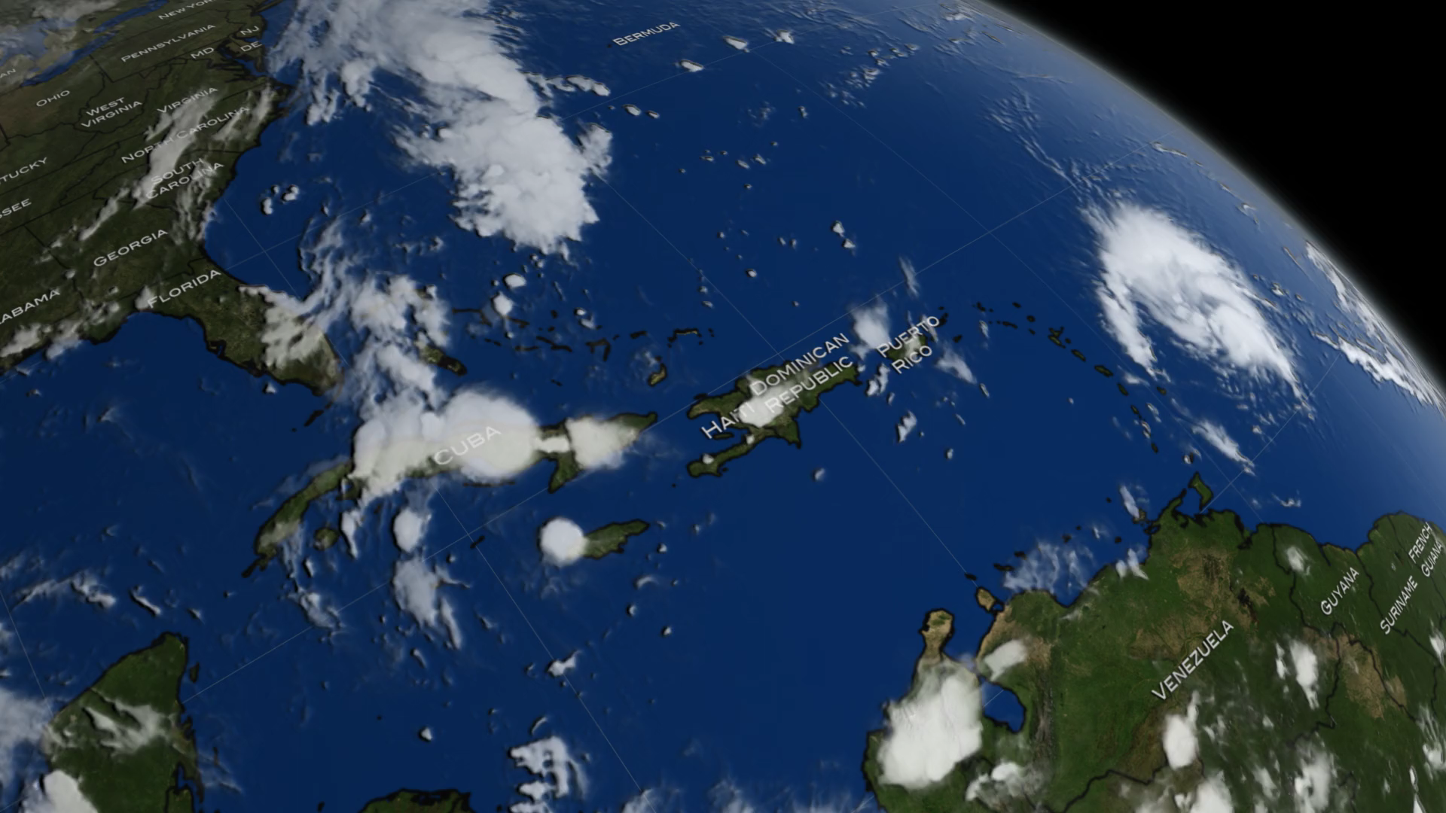
Notes:
NASA's Global Precipitation Measurement mission or GPM core observatory satellite flew over Hurricane Matthew as the category 4 hurricane on October 2, 2016 shortly after it downgraded from a category 5 hurricane.
The GPM Core Observatory carries two instruments that show the location and intensity of rain and snow, which defines a crucial part of the storm structure – and how it will behave. The GPM Microwave Imager sees through the tops of clouds to observe how much and where precipitation occurs, and the Dual-frequency Precipitation Radar observes precise details of precipitation in 3-dimensions.
GPM data is part of the toolbox of satellite data used by forecasters and scientists to understand how storms behave. GPM is a joint mission between NASA and the Japan Aerospace Exploration Agency. Current and future data sets are available with free registration to users from
http://pps.gsfc.nasa.gov/
NASA Goddard's Precipitation Processing Center website.

